Slide 1

160/100
140/80

Slide 2




Target: >140/80
28000 rows (100%)
7000 rows (25%)
4900 rows (17.5%)
3500 rows (12.5%)
2800 rows (10%)
9300 rows (33.3%)
9300 rows (20%)

Slide 3





Runs when changing the number of variables (columns) inputted into the model with different subsets (rows)

Slide 4

All 10 combination of 10% subset runs

Slide 5


Slide 6

All 10 combination of 10% subset runs – variable weighting distribution

Slide 7



Handling abnormally high distance values in cPC (test on 20% subset ~5600 rows)
1) Original
(Minimum Spanning Tree)
2) Filter out large values in cPC space (set values above 3sd as the median)
3) Shortest Path Tree Instead of Minimum Spanning Tree
4) #2 (filter) + #3 (use shortest path tree)
DON’T USE SHORTEST PATH TREE AS THIS DOESN’T MAKE THE RIGHT TRAJECTORY GRAPH STOOOOOPID !!!!!!!!
Note that #2 is currently flawed as we cannot just reassign these abnormally large values in cPC space with the median (around 0), they should be instead replaced somehow by their next closest node ….

Slide 8




Distribution of values in cPC and results
Filter out cPCs (tests)
Raw cPC
Zoomed in

Slide 9










Distribution of values in distance matrix used for MST/shortest path trajectory calculation

Slide 10

Distribution of Values for each contrastive principle component in a 20% subset run

Slide 11



Boxcox Problems
Raw input data
Data after boxcox transformation
Boxcox:$T\left(X\right)=\frac{Xλ−1}{λ}$
When lambda is very small (i.e. 0.01), it can cause these massive negative values
Min = -80 ???

Slide 12


Issues with covariance matrix and eigen decomposition
Limited range for alpha to avoid large outliers seen at larger alphas
Filter out large values from eigen decomposition
Use shortest path tree instead

Slide 13








Compare Intermediate Results Pairs for 100% (left) vs 10% (right)
Covariance of Background Population
Eigen Decomposition for All Alpha
Eigen Decomposition Medoids (Nodal Weights) for all Alpha
Covariance of Target Population
Eigen Values for All Alpha
Medoids (Nodal Weights) for Best Alphas
Affinity Matrix
cPCs

Slide 14

Covariance of background for full data (green) vs 10% data (red)

Slide 15
NeuroPM Toolbox Outline
Assumption: Given a large cohort of patients, we can assume they are at different stages of disease, and therefore produce a pseudo-temporal distribution of the progression of disease
Data: Given a matrix of N rows (patients) by M columns (features), separate rows into background/between/disease categories
Dimensionality Reduction
Compute the covariance matrix for the nodes in each of the background (C_{b}) or disease (C_{d}) categories
Define a range of values α = 10⁻² to 10²
For each α calculate a new combined covariance matrix where C = C_{d} – αC_{b} such that the C gets less/more weighted towards the covariance of the background category
Perform eigen decomposition to get the principle components (PC) for each C, each column is the eigen vector of each feature and the diagonal elements are the eigen values
For each α keep the PCs with the largest eigen values, the max number to keep is predefined
Compute affinity matrix of the PCs for each combination of α using cosine similarity
Use spectral clustering of the affinity matrix a pre-set number times and choose the cluster (set of α) with the highest value of clustering quality
For each unique group in the cluster
Identify the associated subset of the affinity matrix in the group and find the α corresponding to the maximum similarity
Find the eigen decomposition with the associated α computed from above, these are the PCs of interest for this cluster group
Perform matrix multiplication between the entire input dataset and the PC identified to project the data onto the α space and obtain the cPC
Use K-Means clustering on the rows in the cPC in the background/disease groups to compute the clustering tendency of the disease vs background
The final cPC is the cPC from the cluster group which produces the maximum clustering tendency of the background/disease groups as this means the values are clustered more tightly and the clusters have less overlap
TLDR: perform PCA on a range of weighted sums of the background/disease, the final cPC then corresponds to the weighting variable which produces the highest clustering tendency of the background/disease in the PC space
Tree Generation
Treat each row of the cPC space as a node
Define a complete graph where every node is connected where the weights of the branch is the L2 distance between the values in the cPC space, do this for only the background and disease nodes
Find the node in the background category which has the overall smallest distance to every other node, set this as the root node
Compute the minimum spanning tree starting from the root node across the entire graph (prims algorithm)
Trajectory Inference/Pseudo-Time Score Calculation
Calculate the pseudo-time (or disease progression) score for each node in the background/disease categories as the shortest distance (Dijkstra) from the node to the root node along the minimum spanning tree
The pseudo-time score of the nodes in the between category is then extrapolated as the pseudo-time score of the node in the background/disease categories with the shortest distance in the cPC space from the between node
The trajectories of disease progression are the major branches of the minimum spanning tree which is open for interpretation depending on how much variation you want to include

Slide 16







Combining the outputs of individual runs into one graph (concatenate outputs of cPCA function, sum variable contributions)
Merged 1-9000
1-3000
Merged 1-6000
Merged 1-6000
Fix Between Group A Bit (sometimes makes it better, sometimes doesn’t)
Merged 1-15000
Can further improve these by tuning tree generation, filter cPC outliers, (filter out eigen vectors), defining more extreme target population
3001-6000
Merged 1-12000

Slide 17


Trajectory plotting (basic plotting using Matlab)
3000 Patients (10%)
15000 Patients (50%)

Slide 18



Improving full cPCA runs (single batch) by changing the number of max cPCs and number of clusters
Best: max cPC = 250, filter out eigen vectors in cPCA with large values, 100 clusters for clustering tendency, 160/100 target
As Above
+ Filter out large eigen vec values
+ Eigen Value Threshold >0.01

Slide 19





Run cPCA on sub-batches and combine individual cPCs when generating the final tree/disease scores (140/80)
5 Batches
(6000 Patients Each)
10 Batches
(3000 Patients Each)
15 Batches
(2000 Patients Each)
20 Batches
(1500 Patients Each)
25 Batches
(1200 Patients Each)

Slide 20





Run cPCA on sub-batches and combine individual cPCs when generating the final tree/disease scores (160/100)
5 Batches
(6000 Patients Each)
10 Batches
(3000 Patients Each)
15 Batches
(2000 Patients Each)
20 Batches
(1500 Patients Each)
25 Batches
(1200 Patients Each)

Slide 21





Run cPCA on sub-batches and combine individual cPCs when generating the final tree/disease scores (160/100)
8 Batches
(3500 Patients Each)
13 Batches
(2200 Patients Each)
17 Batches
(1700 Patients Each)
22 Batches
(1300 Patients Each)
28 Batches
(1000 Patients Each)

Slide 22

Trajectory Visualization (Python Plotly)

Slide 23


Slide 24



Running Using Different Variable Subsets (10 batches) disease >160/100
(note row numbers are different as the same filtering conditions were using during sub setting to ensure minimal missing data)
Cardiac Variables
(23652 x 35)
Brain Variables
(34798 x 861)
Cardiac + Brain + Carotid Variables
(34597 x 895)

Slide 25

Running Using Different disease definitions (10 batches)
(using all rows and don’t exclude patients with events)
160/100 (filter out patients with events)
160/100 (all patients)
Event at time of imaging
No event at time of imaging but at follow up

Slide 26



Running Using Different row sub setting (10 batches) disease: > 160/100
Male only
Female only
No Events at time of Imaging
Female only, No Events at time of Imaging

Slide 27
AUROC (Area Under Receiver Operating Characteristic Curve)
AUC = 0.99885
0.092
0.049

Slide 28
Model Stability - Cross Validation Evaluation
10 – fold cross validation
cPCA 10 batches (Compare Folds Between Themselves):
Root Mean Squared Error is: 0.13 +- 0.07 [0.05, 0.31]
Mean Standard Deviation is: 0.05 +- 0.03 [0.02, 0.11]
full_cPCA (Compare Folds Between Themselves):
Root Mean Squared Error is: 0.09 +- 0.06 [0.05, 0.25]
Mean Standard Deviation is: 0.03 +- 0.02 [0.02, 0.08]
cPCA 10 batches (Compare Against Full Run):
Root Mean Squared Error is: 0.09 +- 0.05 [0.03, 0.23]
Mean Standard Deviation is: 0.05 +- 0.03 [0.02, 0.11]
full_cPCA (Compare Against Full Run):
Root Mean Squared Error is: 0.06 +- 0.04 [0.02, 0.18]
Mean Standard Deviation is: 0.03 +- 0.02 [0.02, 0.08]
20 – fold cross validation
30 – fold cross validation
cPCA 10 batches (Compare Folds Between Themselves):
Root Mean Squared Error is: 0.13 +- 0.08 [0.04, 0.31]
Mean Standard Deviation is: 0.05 +- 0.03 [0.01, 0.11]
cPCA 10 batches (Compare Against Full Run):
Root Mean Squared Error is: 0.07 +- 0.04 [0.02, 0.17]
Mean Standard Deviation is: 0.05 +- 0.03 [0.01, 0.11]
cPCA 10 batches (Compare Folds Between Themselves):
Root Mean Squared Error is:
Mean Standard Deviation is:
cPCA 10 batches (Compare Against Full Run):
Root Mean Squared Error is: 0.07 +- 0.04 [0.02, 0.17]
Mean Standard Deviation is: 0.05 +- 0.03 [0.02, 0.11]

Slide 29
Predicting Disease Scores Using KNN (on 10-Fold Cross Validation Data)
Using K = 5
Fold 1: Predictions were 0.060 from the Ground Truth (Accuracy = 94.0%, N = 2801)
Fold 2: Predictions were 0.065 from the Ground Truth (Accuracy = 93.5%, N = 2801)
Fold 3: Predictions were 0.055 from the Ground Truth (Accuracy = 94.5%, N = 2801)
Fold 4: Predictions were 0.058 from the Ground Truth (Accuracy = 94.2%, N = 2801)
Fold 5: Predictions were 0.056 from the Ground Truth (Accuracy = 94.4%, N = 2801)
Fold 6: Predictions were 0.061 from the Ground Truth (Accuracy = 93.9%, N = 2801)
Fold 7: Predictions were 0.063 from the Ground Truth (Accuracy = 93.7%, N = 2801)
Fold 8: Predictions were 0.062 from the Ground Truth (Accuracy = 93.8%, N = 2801)
Fold 9: Predictions were 0.055 from the Ground Truth (Accuracy = 94.5%, N = 2801)
Fold 10: Predictions were 0.055 from the Ground Truth (Accuracy = 94.5%, N = 2803)
Overall: 10-Fold X-Validation Results in an Average Error of 0.06 (Accuracy = 94.1%)

Slide 30
Predicting Disease Scores Using KNN, Predicted Values in Fold 1
(0 = Between, 1 = Background, 2 = Disease)

Slide 31
Predicting Disease Scores Using KNN (on 10-Fold Cross Validation Data), with Sensitivity + Specificity Evaluation Scores Added
Using K = 5
[1] "------------------------------ Evaluating Fold 1"
[1] "RMSE = 0.152 (N = 2801)"
[1] "Optimal Threshold at 0.137 (Sensitivity = 66.9%, Specificity = 53.8%, F1 = 43.6%)"
[1] "------------------------------ Evaluating Fold 2"
[1] "RMSE = 0.131 (N = 2801)"
[1] "Optimal Threshold at 0.118 (Sensitivity = 73.2%, Specificity = 43.3%, F1 = 62.5%)"
[1] "------------------------------ Evaluating Fold 3"
[1] "RMSE = 0.139 (N = 2801)"
[1] "Optimal Threshold at 0.154 (Sensitivity = 54.0%, Specificity = 65.6%, F1 = 38.8%)"
[1] "------------------------------ Evaluating Fold 4"
[1] "RMSE = 0.147 (N = 2801)"
[1] "Optimal Threshold at 0.170 (Sensitivity = 24.0%, Specificity = 86.4%, F1 = 30.5%)"
[1] "------------------------------ Evaluating Fold 5"
[1] "RMSE = 0.157 (N = 2801)"
[1] "Optimal Threshold at 0.136 (Sensitivity = 73.4%, Specificity = 45.6%, F1 = 43.7%)"
[1] "------------------------------ Evaluating Fold 6"
[1] "RMSE = 0.150 (N = 2801)"
[1] "Optimal Threshold at 0.134 (Sensitivity = 64.8%, Specificity = 53.9%, F1 = 54.0%)"
[1] "------------------------------ Evaluating Fold 7"
[1] "RMSE = 0.120 (N = 2801)"
[1] "Optimal Threshold at 0.086 (Sensitivity = 91.7%, Specificity = 16.0%, F1 = 75.4%)"
[1] "------------------------------ Evaluating Fold 8"
[1] "RMSE = 0.129 (N = 2801)"
[1] "Optimal Threshold at 0.092 (Sensitivity = 91.5%, Specificity = 15.1%, F1 = 71.7%)"
[1] "------------------------------ Evaluating Fold 9"
[1] "RMSE = 0.128 (N = 2801)"
[1] "Optimal Threshold at 0.084 (Sensitivity = 88.6%, Specificity = 18.8%, F1 = 71.0%)"
[1] "------------------------------ Evaluating Fold 10"
[1] "RMSE = 0.156 (N = 2803)"
[1] "Optimal Threshold at 0.116 (Sensitivity = 86.3%, Specificity = 25.3%, F1 = 51.1%)"
[1] "Overall: 10-Fold X-Validation Results in an RMSE of 0.141"
[1] "Mean by Group:"
Group.1 err knn_dist
1 0 0.1447097 855.6133
2 1 0.1305062 833.8211
3 2 0.1339628 873.3766
Higher RMSE as adjusting thresholds to get better sensitivity/specificity

Slide 32
Variable Correlations – Initial Investigation (cPCA 10 Batches)
Variables with Statistically Significant Pearson Correlations

Slide 33
Variable Correlations + Node Contribution – Original cPCA (No Batches)

Slide 34
Variable Correlations – Original cPCA (No Batches)
> 900 Significant Variables

Slide 35
Variable Correlations – cPCA with 10 Batches
37 Significant Variables

Slide 36

Analysing Variable Correlation in 6000 Patient Full Run (~20%)
First Seeing the Model (Using 1st 6000 Patients in Dataset)
[1] "Overlap in IQR of Background vs Between is 31.0% (Background) 19.5% of (Between)“
[1] "Overlap in IQR of Boxes Between vs Disease is 25.2% (Between) 14.9% (Disease)“
[1] "Overlapping Interval of Scores is 7.7% of the entire range (0.036 to 0.113)"
[1] "% of Samples in the Background Group with Non-Overlapping Scores is 36.7%"
[1] "% of Samples in the Disease Group with Non-Overlapping Scores is 56.6%"
[1] "AUC is 0.95156 when using 1001 Logarithmic Intervals“
[1] "Optimal Threshold at 0.079 (Sensitivity = 83.9%, Specificity = 92.3%)"

Slide 37
Induce Scaling Factors During Tree Generation of Different Groups to Enhance Separation
In 6000 Patient Full Run (~20%)
Scale = [1, 10, 10]
Scale = [1, 5, 10]
Scale = [1, 5, 7]
Scale = [1, 6, 7]
(filter out large cPCs)
Scale = [1, 7.5, 10]
(filter out large cPCs)

Slide 38

Induce Scaling Factors During Tree Generation of Different Groups to Enhance Separation
Full Dataset
[1] "Overlap in IQR of Background vs Between is -155.1% (Background) -19.2% of (Between)"
[1] "Overlap in IQR of Boxes Between vs Disease is 14.1% (Between) 10.3% (Disease)"
[1] "Overlapping Interval of Scores is 2.2% of the entire range (0.052 to 0.074)"
[1] "% of Samples in the Background Group with Non-Overlapping Scores is 99.1%"
[1] "% of Samples in the Disease Group with Non-Overlapping Scores is 97.6%"
[1] "AUC is 0.99979 when using 1001 Logarithmic Intervals"
[1] "Optimal Threshold at 0.055 (Sensitivity = 99.8%, Specificity = 99.6%)"
Python -- Completed Trajectory Isolation and Visualization
Python -- Successfully Built and Packaged Model
Scale = [1, 7.5, 10]
(filtering out large cPCs, anything larger than 3sd)

Slide 39
Variable Correlations – Scaling Different Groups

Slide 40



Testing subset 1:2800 vs 2:2802
Rows 1:2800
466 Variables Above Threshold
Rows 2:2801
464 Variables Above Threshold
Rows 3:2802
464 Variables Above Threshold
Even when we just have 1 patient different, the variables outputted by cPCA can change pretty significantly, refer to excel spreadsheet for comparison of individual variables sorted by their weighting

Slide 41
Step Back to Running Full Pipeline on Only 6000 Patients

Slide 42
Model on 6,000 Patients in UKB – Initial Validation
Number of cPCs -> 14
Alpha Selected -> 62.8029
[1] "Overlap in IQR of Background vs Between is 31.0% (Background) 19.5% of (Between)“
[1] "Overlap in IQR of Boxes Between vs Disease is 25.2% (Between) 14.9% (Disease)“
[1] "Overlapping Interval of Scores is 7.7% of the entire range (0.036 to 0.113)“
[1] "% of Samples in the Background Group with Non-Overlapping Scores is 36.7%“
[1] "% of Samples in the Disease Group with Non-Overlapping Scores is 56.6%“
[1] "AUC is 0.95156 when using 1001 Logarithmic Intervals“
[1] "Optimal Threshold at 0.079 (Sensitivity = 83.9%, Specificity = 92.3%)“

Slide 43
Model on 6,000 Patients in UKB – Most Weighted Variables
[1] "257 Significant Columns (cTI Selected) Contributed to 74.8% of the Total Weighting“
[1] "274 Significant Columns (cTI + Cor Test) Contributed to 76.0% of the Total Weighting“
[1] "Number of Variables with Statistically Significant Correlations (p < 0.05) is 269“
[1] "Number of Variables with Statistically Significant Correlations (p < 0.001) is 263“
[1] "Number of Variables with Statistically Significant Correlations (p < 0.0001) is 259"

Slide 44
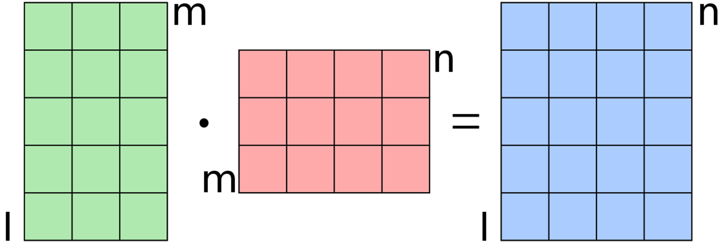
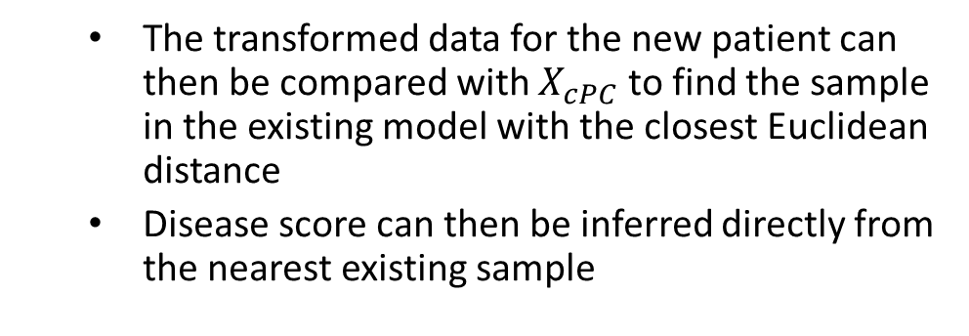
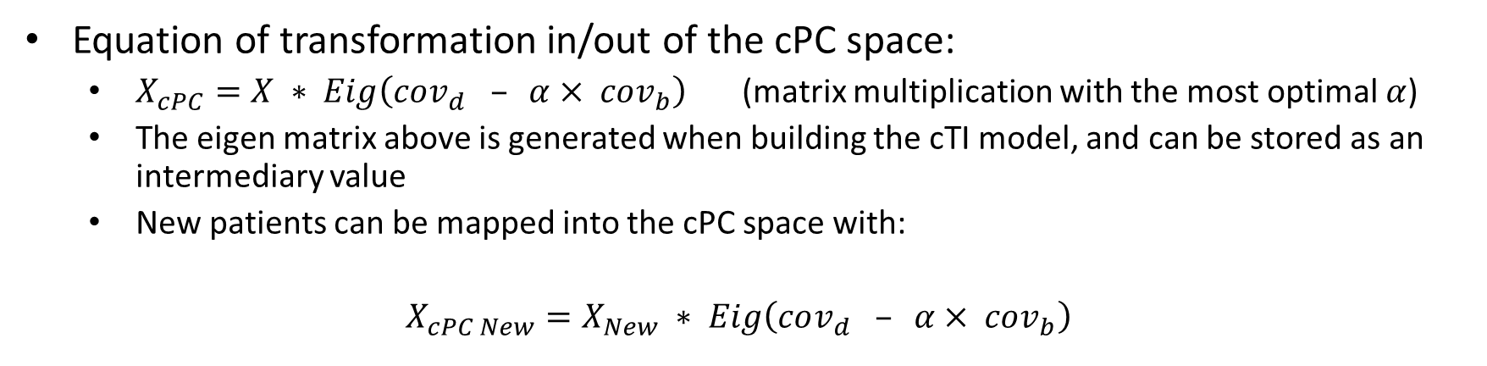
Implementation of cPC Transformation
Equation of transformation in/out of the cPC space:
$X_{cPC}=X ∗ Eig\left(cov_{d} – α× cov_{b}\right)$ (matrix multiplication with the most optimal $α$)
The eigen matrix above is generated when building the cTI model, and can be stored as an intermediary value
New patients can be mapped into the cPC space with:
$X_{cPC New}=X_{New} ∗ Eig\left(cov_{d} – α× cov_{b}\right)$
The transformed data for the new patient can then be compared with $X_{cPC}$ to find the sample in the existing model with the closest Euclidean distance
Disease score can then be inferred directly from the nearest existing sample
New Patient in cPC Space
New Patient(s)
Eigen Matrix

Slide 45
Model on 6,000 Patients in UKB – Stability 10-Fold X-Validation
[1] "Root Mean Squared Error is: 0.04 +- 0.02 [0.01, 0.10]"
[1] "Mean Standard Deviation is: 0.03 +- 0.02 [0.01, 0.08]"
Model on 6,000 Patients in UKB – Predicting New Patients in 10-Fold X-Validation
[1] "Overall: 10-Fold X-Validation Results in an RMSE of 0.020, Sensitivity of 79.5%, Specificity of 81.8%“
[1] "------------------------------ Evaluating Fold 1“
[1] "Optimal Threshold at 0.066 (Sensitivity = 80.1%, Specificity = 81.8%, F1 = 82.4%)“
[1] "------------------------------ Evaluating Fold 2“
[1] "Optimal Threshold at 0.057 (Sensitivity = 83.4%, Specificity = 78.1%, F1 = 85.3%)“
[1] "------------------------------ Evaluating Fold 3“
[1] "Optimal Threshold at 0.064 (Sensitivity = 86.4%, Specificity = 73.7%, F1 = 83.5%)“
[1] "------------------------------ Evaluating Fold 4“
[1] "Optimal Threshold at 0.061 (Sensitivity = 79.7%, Specificity = 80.1%, F1 = 82.1%)“
[1] "------------------------------ Evaluating Fold 5“
[1] "Optimal Threshold at 0.073 (Sensitivity = 77.9%, Specificity = 85.5%, F1 = 79.2%)“
[1] "------------------------------ Evaluating Fold 6“
[1] "Optimal Threshold at 0.079 (Sensitivity = 73.9%, Specificity = 87.0%, F1 = 75.4%)“
[1] "------------------------------ Evaluating Fold 7“
[1] "Optimal Threshold at 0.092 (Sensitivity = 74.6%, Specificity = 92.7%, F1 = 78.3%)“
[1] "------------------------------ Evaluating Fold 8“
[1] "Optimal Threshold at 0.049 (Sensitivity = 85.9%, Specificity = 69.1%, F1 = 86.2%)“
[1] "------------------------------ Evaluating Fold 9“
[1] "Optimal Threshold at 0.090 (Sensitivity = 71.6%, Specificity = 86.8%, F1 = 71.6%)“
[1] "------------------------------ Evaluating Fold 10“
[1] "Optimal Threshold at 0.065 (Sensitivity = 82.2%, Specificity = 83.4%, F1 = 85.0%)“
[1] "Mean by Group:"
Group.1 err knn_dist1
0 0.01850807 0.119252542
1 0.01192587 0.023886133
2 0.06016968 0.20777069
Using KNN (K = 1) in the PC space

Slide 46

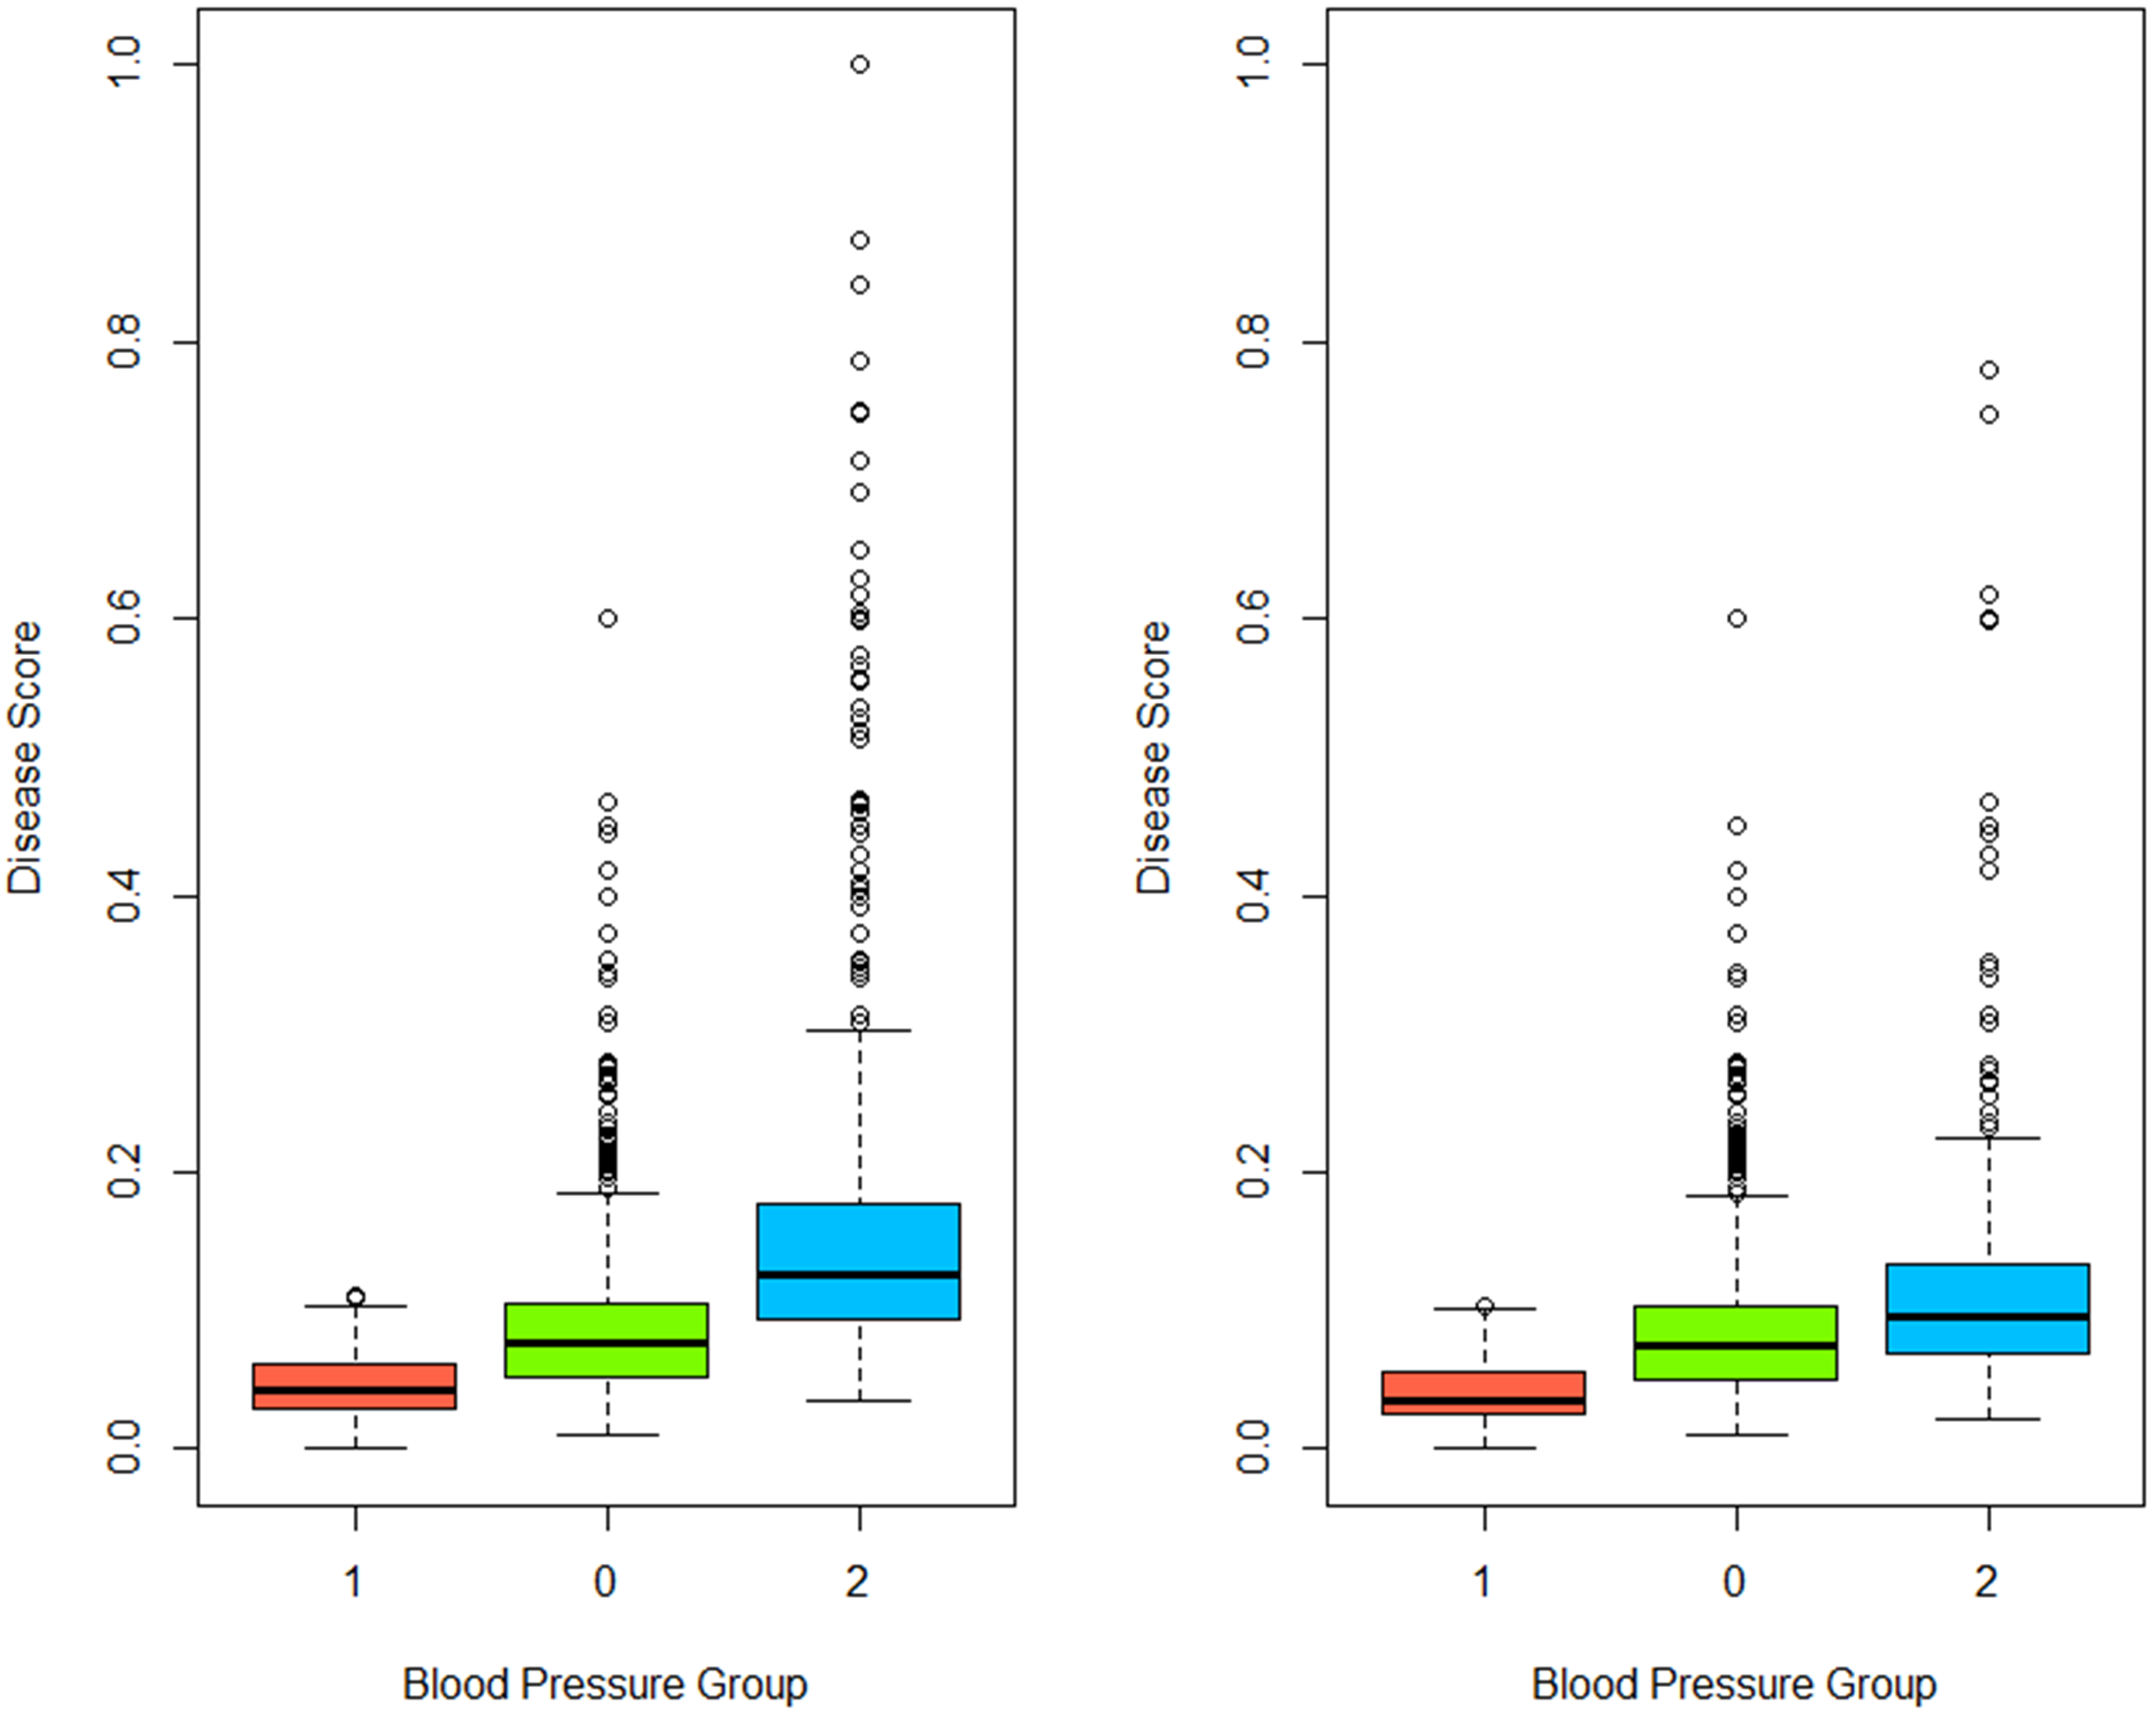
Validation – cTI Model Prediction
To recap: overall 10-fold cross validation resulted in an RMSE of 0.020
Errors for each group were:
Background = 0.019 RMSE
Between = 0.012 RMSE
Disease = 0.060 RMSE
Larger error for disease group
Predictions weren’t able to capture full range of scores
Predicted Scores Over 10-Folds of Cross-Validation
cTI Modelled Scores

Slide 47
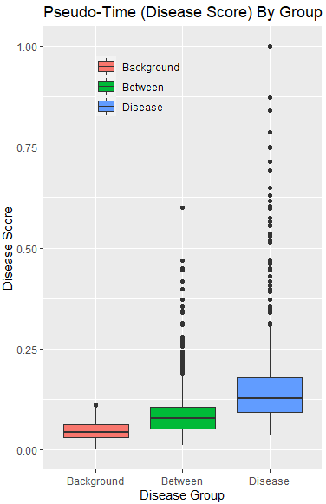
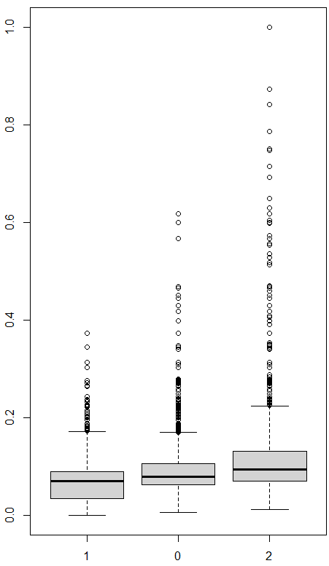
Using Existing Model (Developed on 20% of the Data) To Predict the Remaining 80%
cTI on 20% of data
Predict Remaining 80% of Data

Slide 48
Feature Selection & Other Filtering

Slide 49
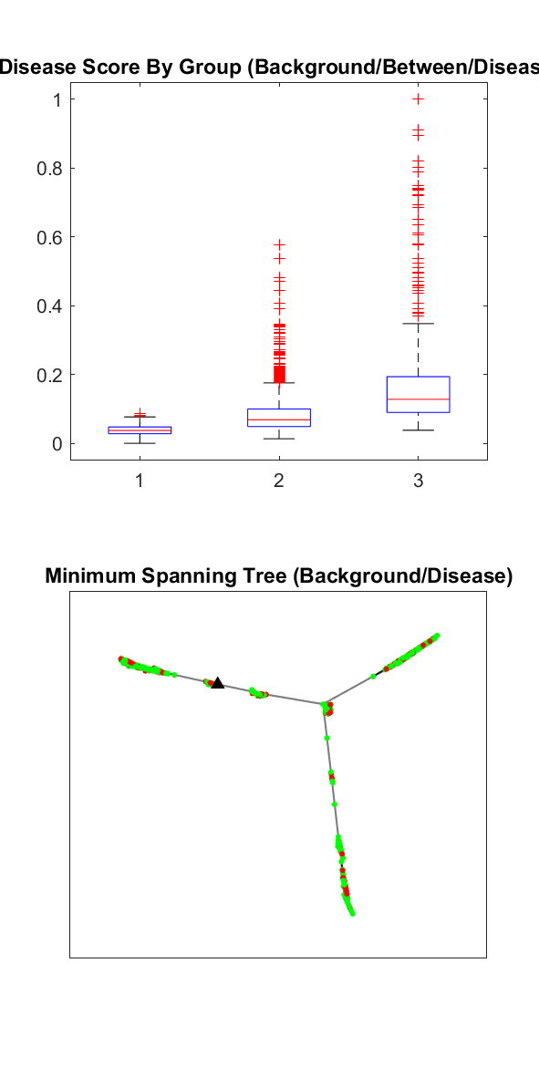
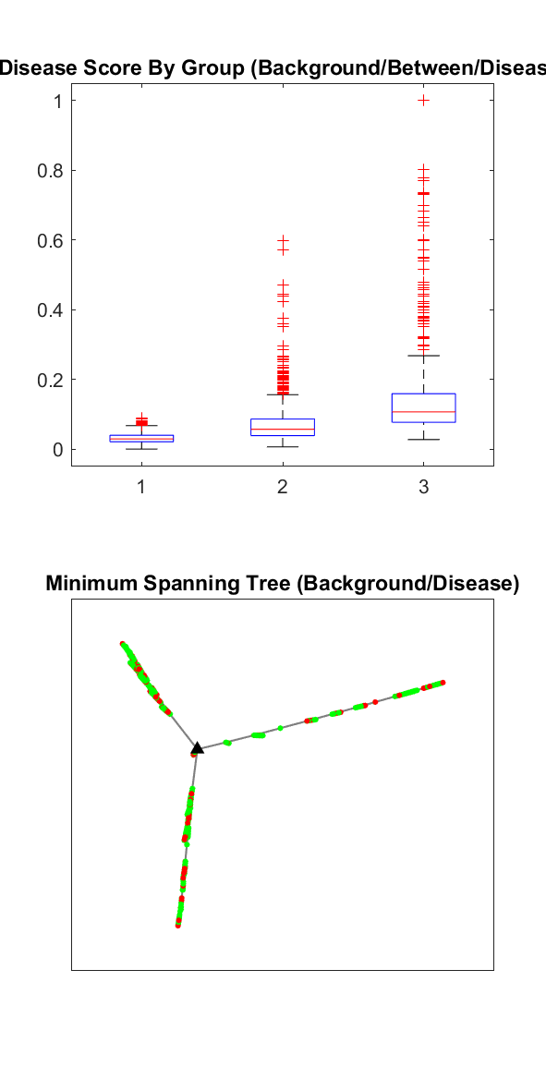
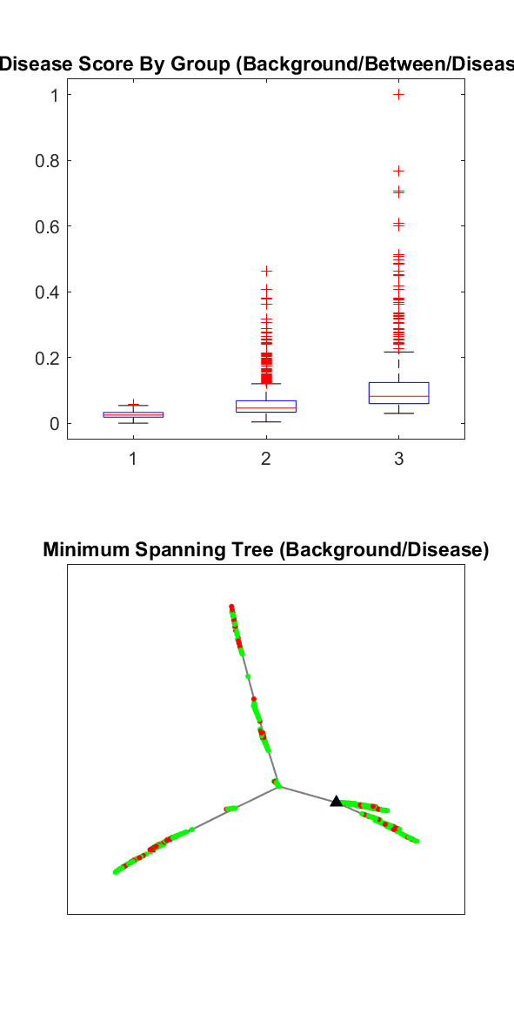
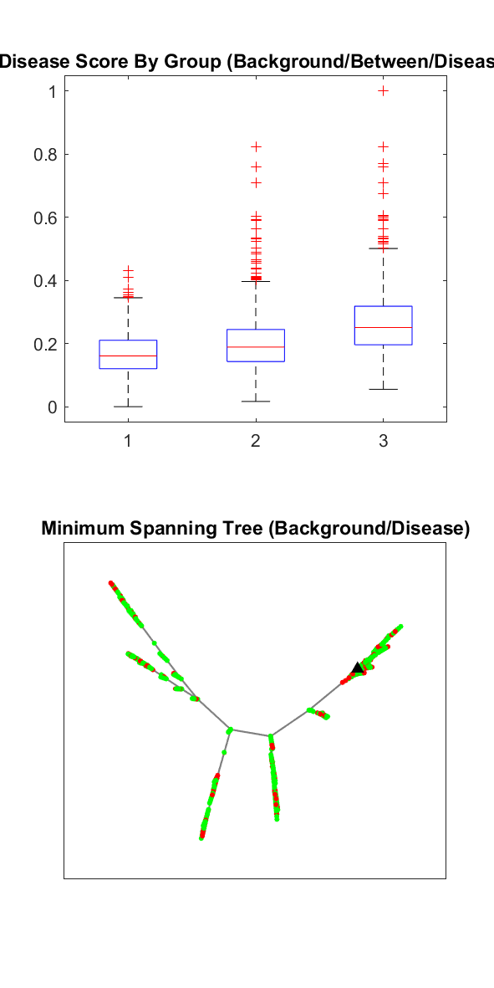
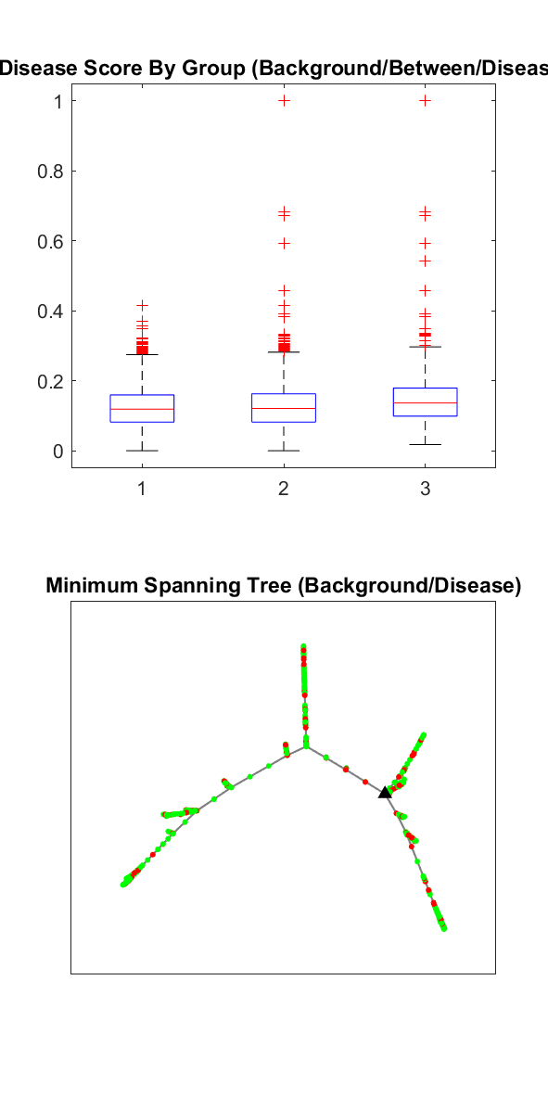
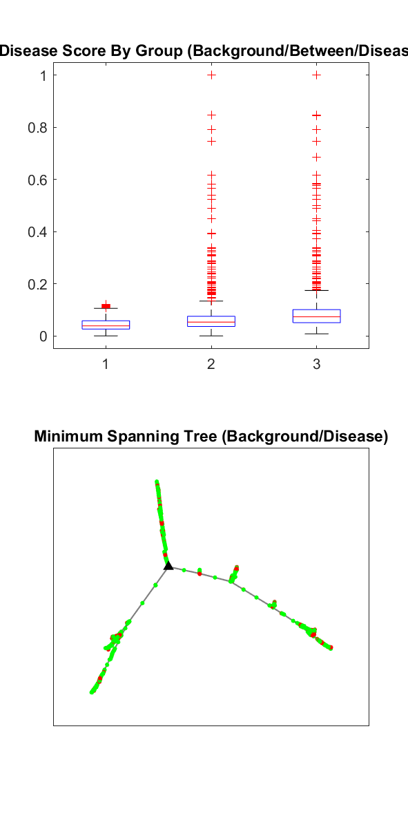
Remove High Co-Correlated Variables (20% of Data)
All Variables
Remove Variables > 0.95 Covariance
Remove Variables > 0.9 Covariance
Remove Variables with > 0.75 Covariance
Remove Variables with < 0.9 Covariance
Remove Variables with < 0.75 Covariance

Slide 50
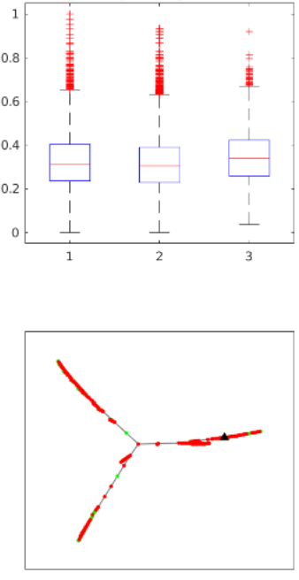
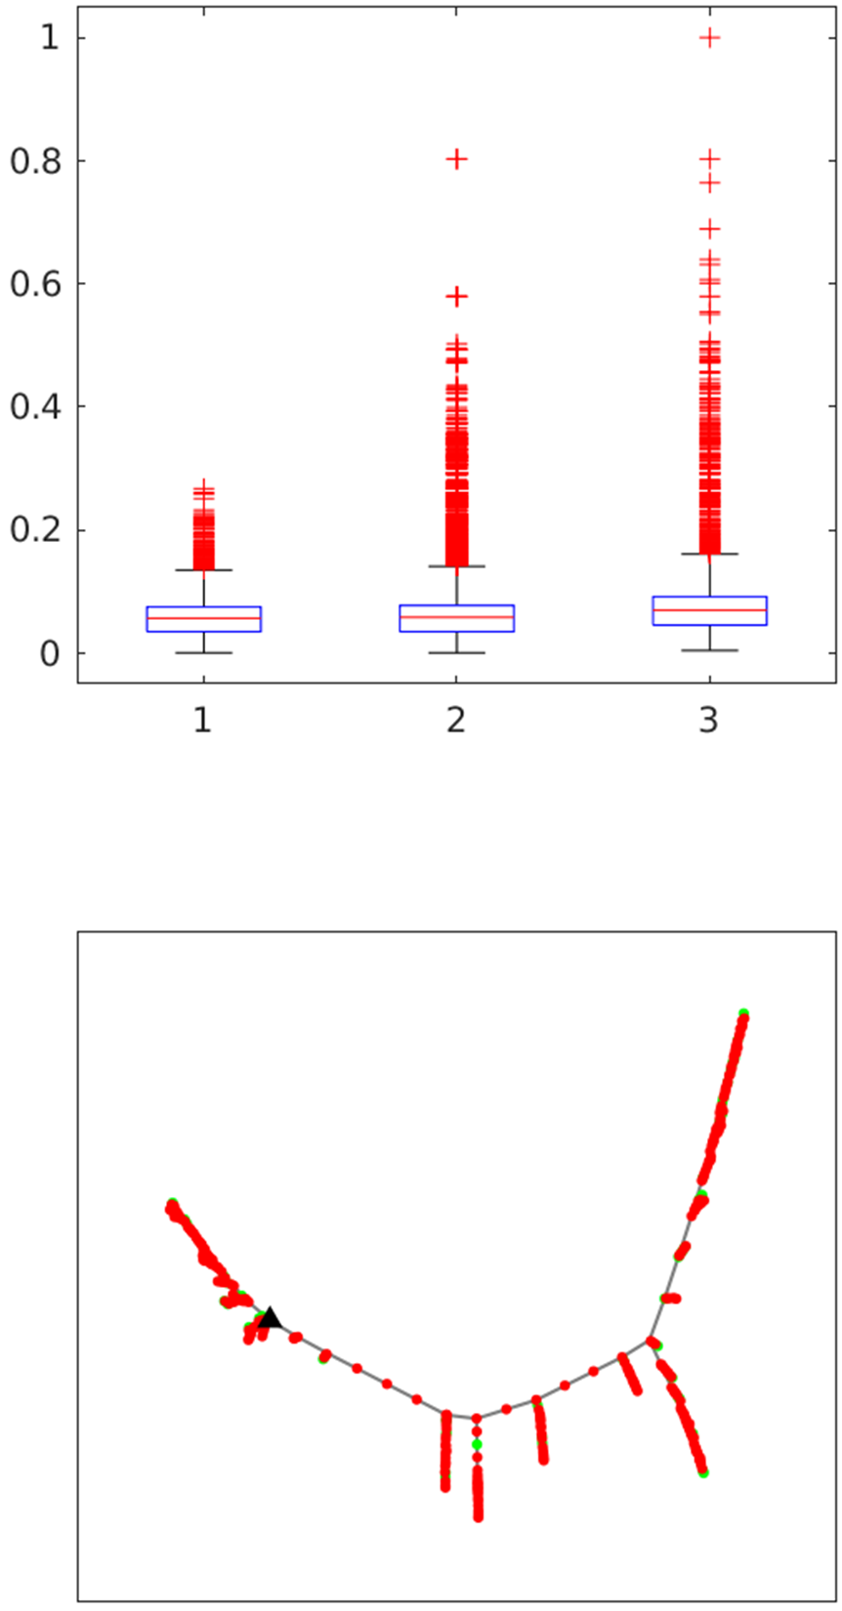
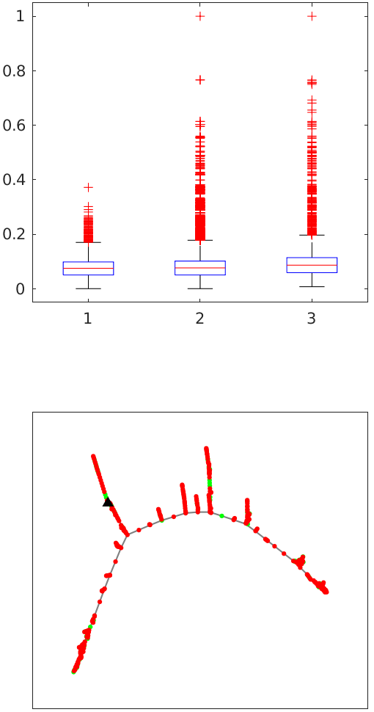
Different Subsets of Features
Disease Scores for Each Group
Disease Scores for Each Group
Disease Scores for Each Group
Cardiac Variables
(23652 x 35)
Brain Variables
(34798 x 861)
Cardiac + Brain + Carotid Variables
(34597 x 895)

Slide 51
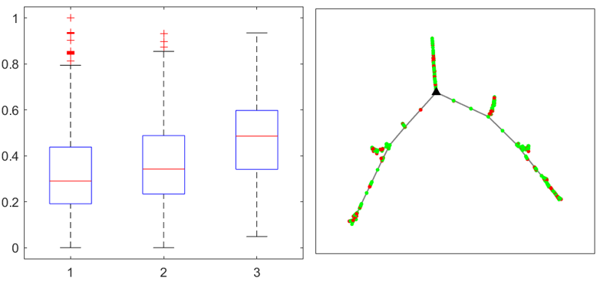
Using Raw Values Instead of cPCA Reduced Values for Trajectory Construction (100% of data)

Slide 52
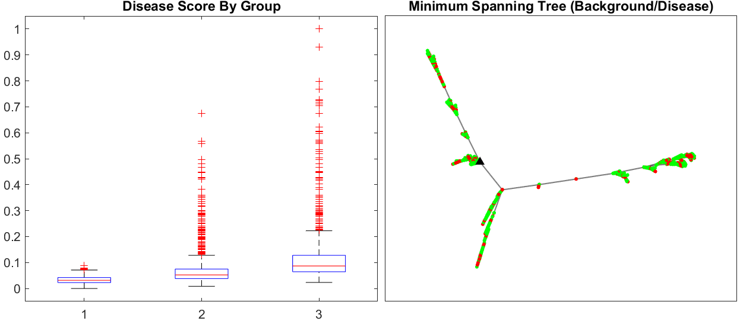
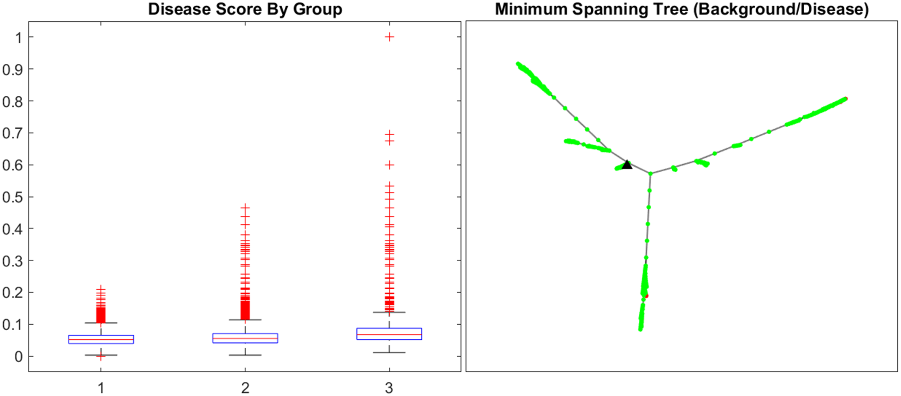
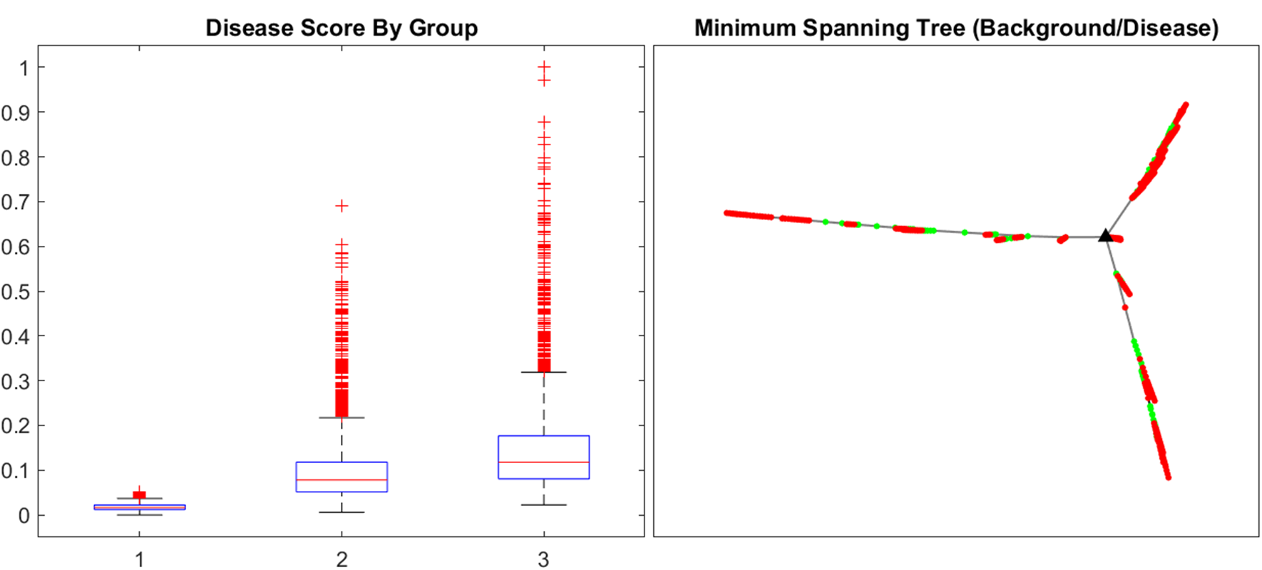
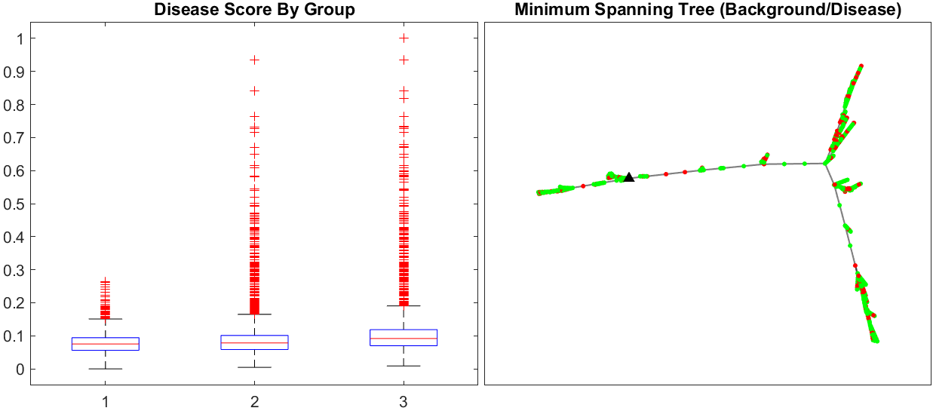
Background (n = 5,858)
Between (n = 20,041)
Disease (n = 2,113)
Use 100% of “Between” and varying % of “Disease” and “Background”
100% of “Between” with 20% of “Background” and 20% of “Disease”
100% of “Between” with 100% of “Background” and 20% of “Disease”
100% of “Between” with 20% of “Background” and 100% of “Disease”
100% of “Between” with 100% of “Background” and 100% of “Disease”

Slide 53
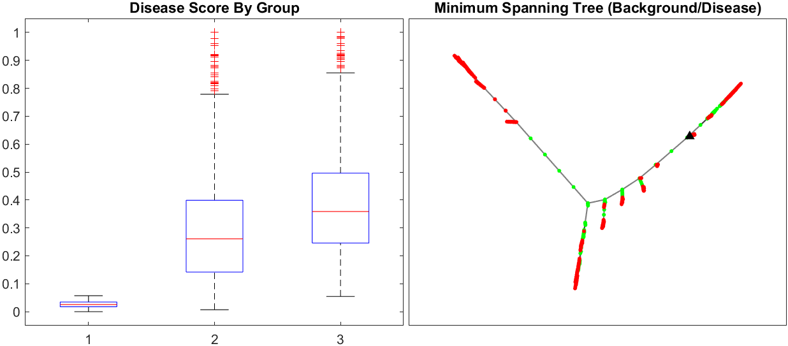
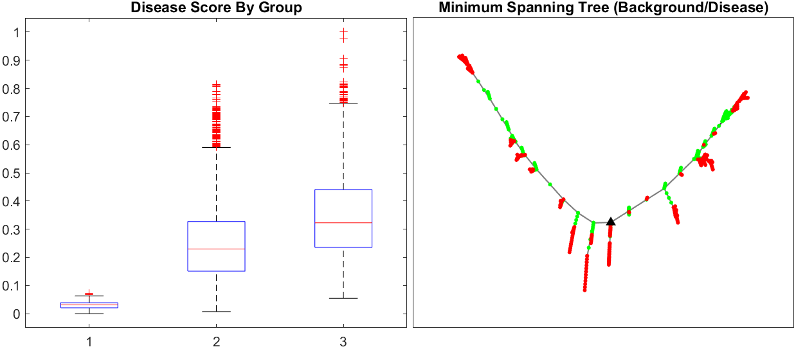
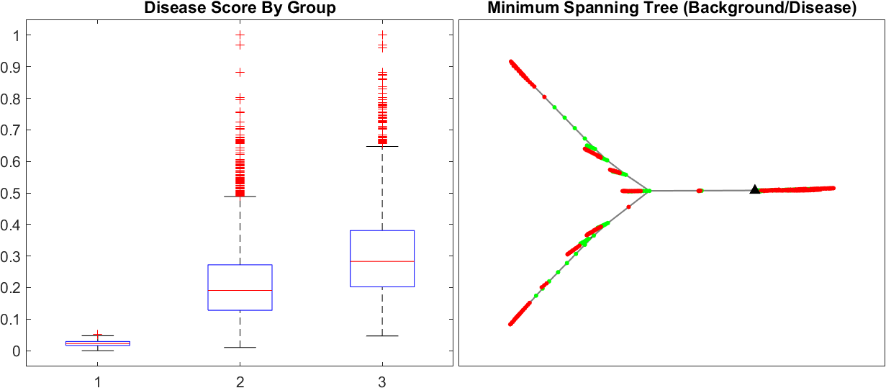
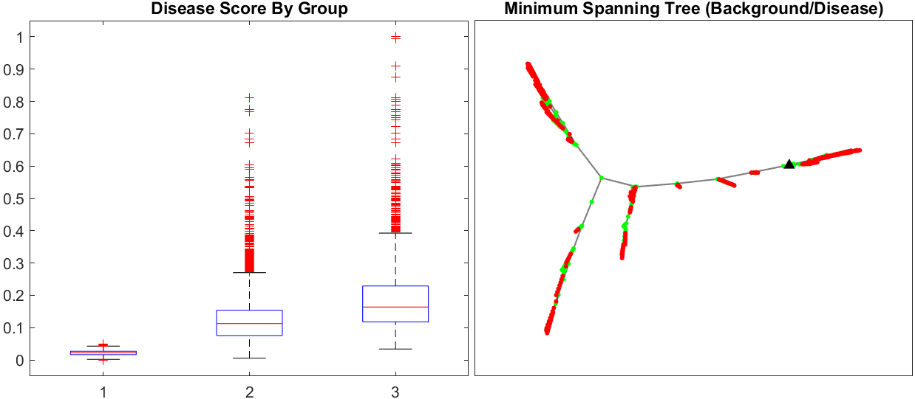
Background (n = 5,858)
Between (n = 20,041)
Disease (n = 2,113)
Use 100% of “Between” and 100% of “Disease” and varying % of “Background”
100% of “Between”/“Disease” and 10% of ”Background”
100% of “Between”/“Disease” and 12.5% of ”Background”
100% of “Between”/“Disease” and 15% of ”Background”
100% of “Between”/“Disease” and 17.5% of ”Background”

Slide 54
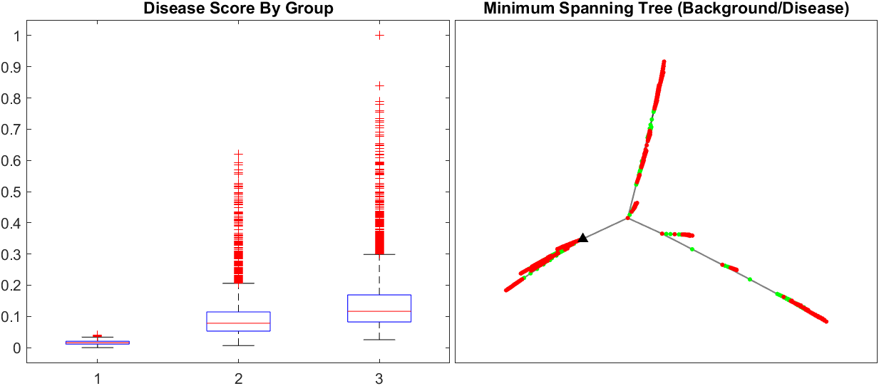
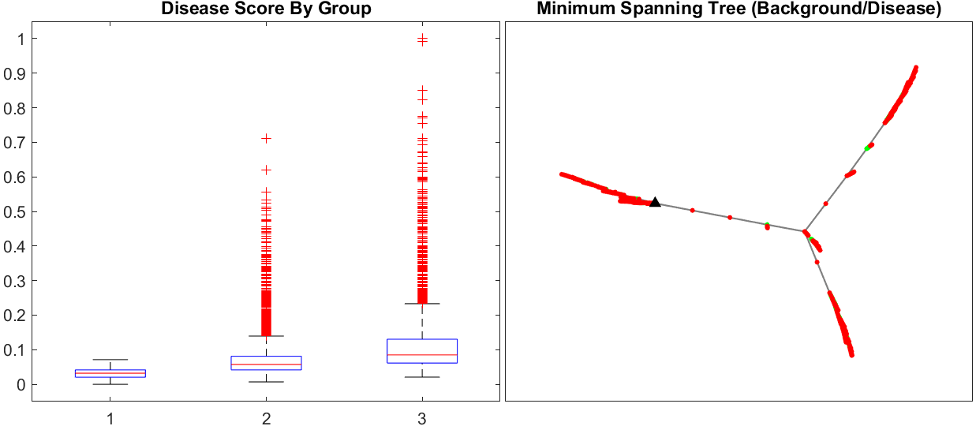
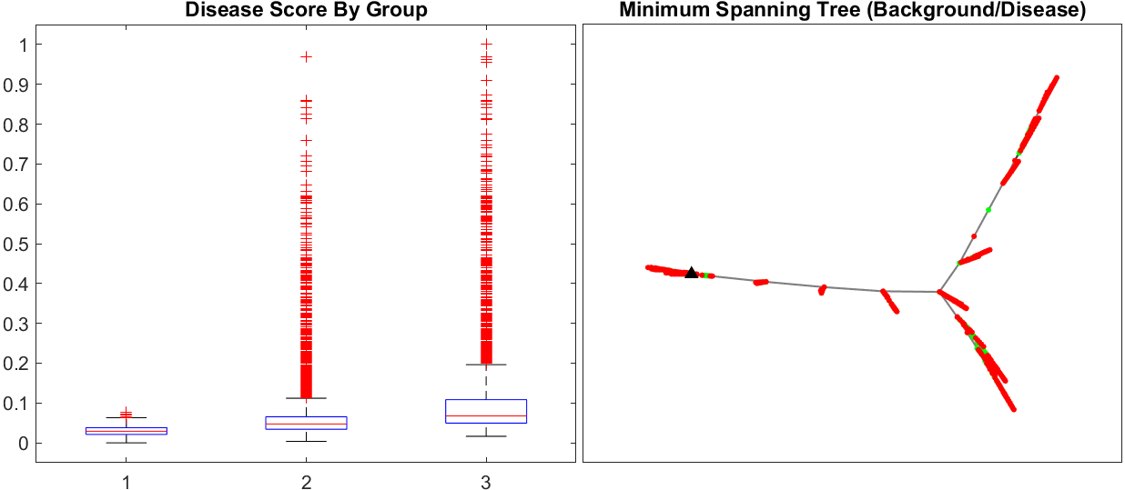
Background (n = 5,858)
Between (n = 20,041)
Disease (n = 2,113)
Use 100% of “Between” and 100% of “Disease” and varying % of “Background”
100% of “Between”/“Disease” and 20% of ”Background”
100% of “Between”/“Disease” and 25% of ”Background”
100% of “Between”/“Disease” and 30% of ”Background”
100% of “Between”/“Disease” and 35% of ”Background”

Slide 55
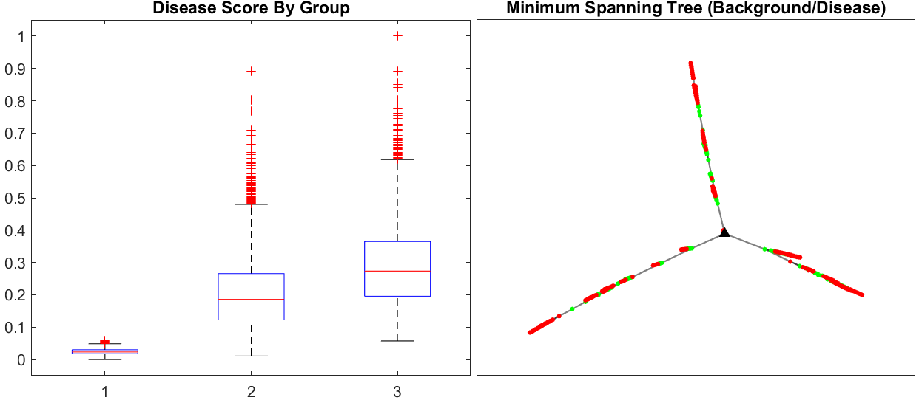
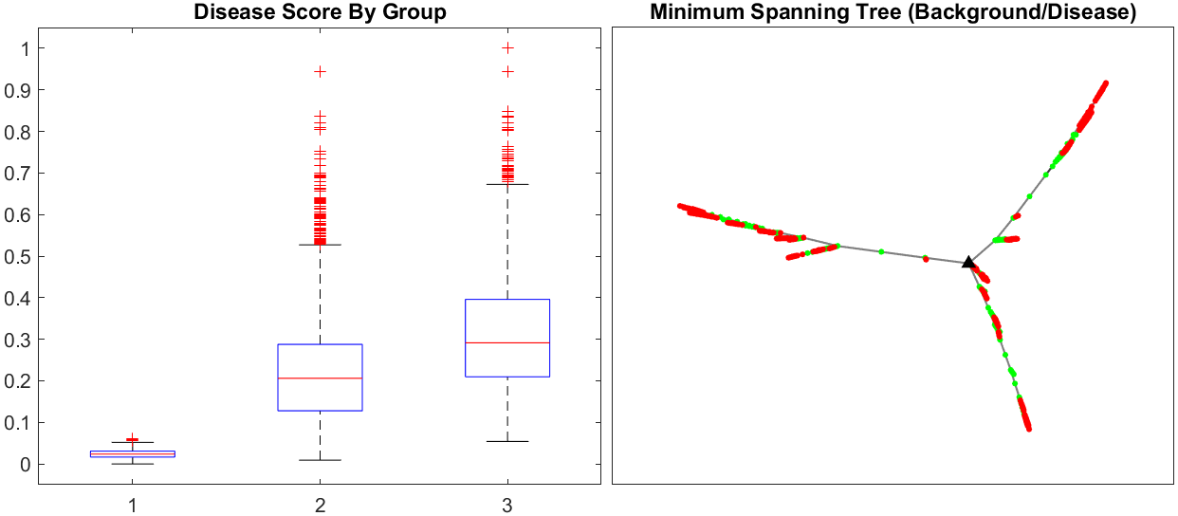
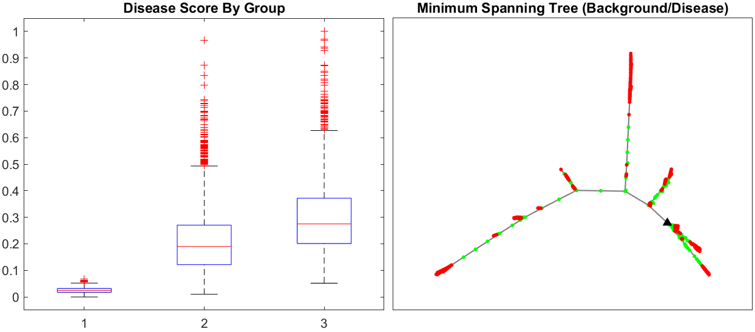
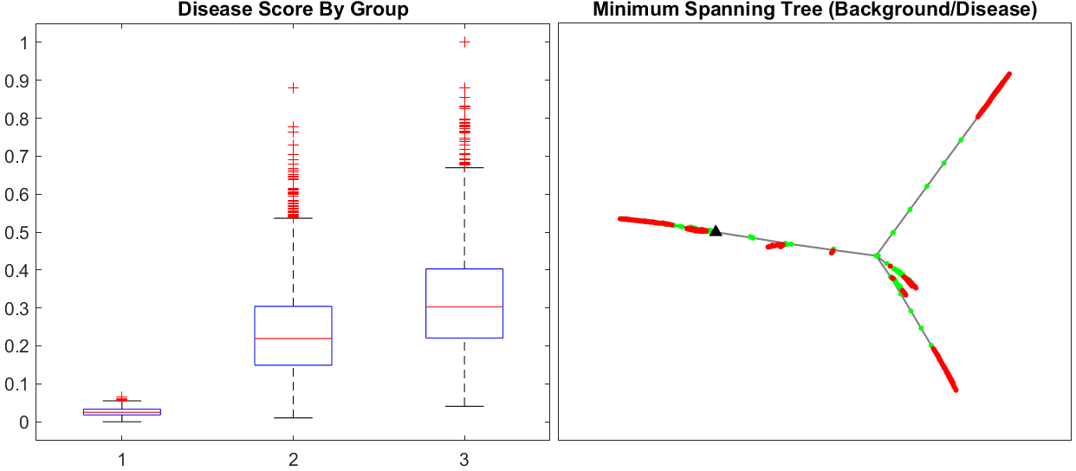
Background (n = 5,858)
Between (n = 20,041)
Disease (n = 2,113)
Use 100% of “Between”/“Disease” and Different Folds of 15% of “Background”
100% of “Between”/“Disease” and 15% of ”Background” (N = ~900) Iteration 1
100% of “Between”/“Disease” and 15% of ”Background” (N = ~900) Iteration 2
100% of “Between”/“Disease” and 15% of ”Background” (N = ~900) Iteration 3
100% of “Between”/“Disease” and 15% of ”Background” (N = ~900) Iteration 4

Slide 56
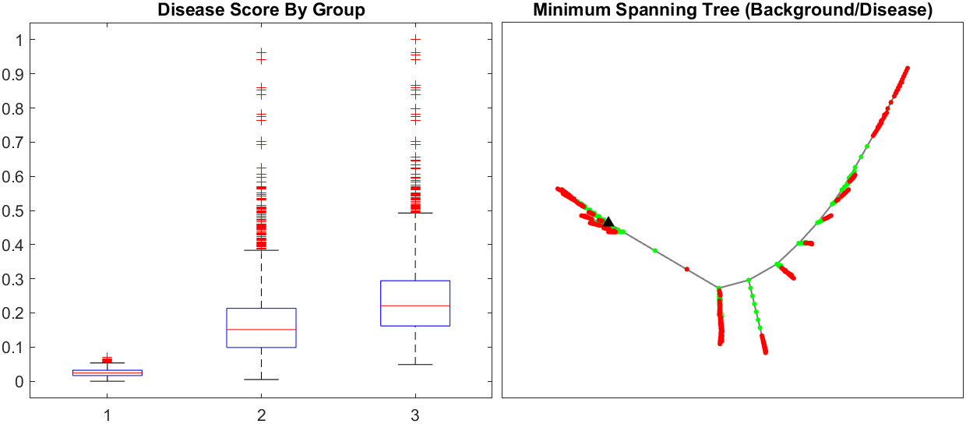
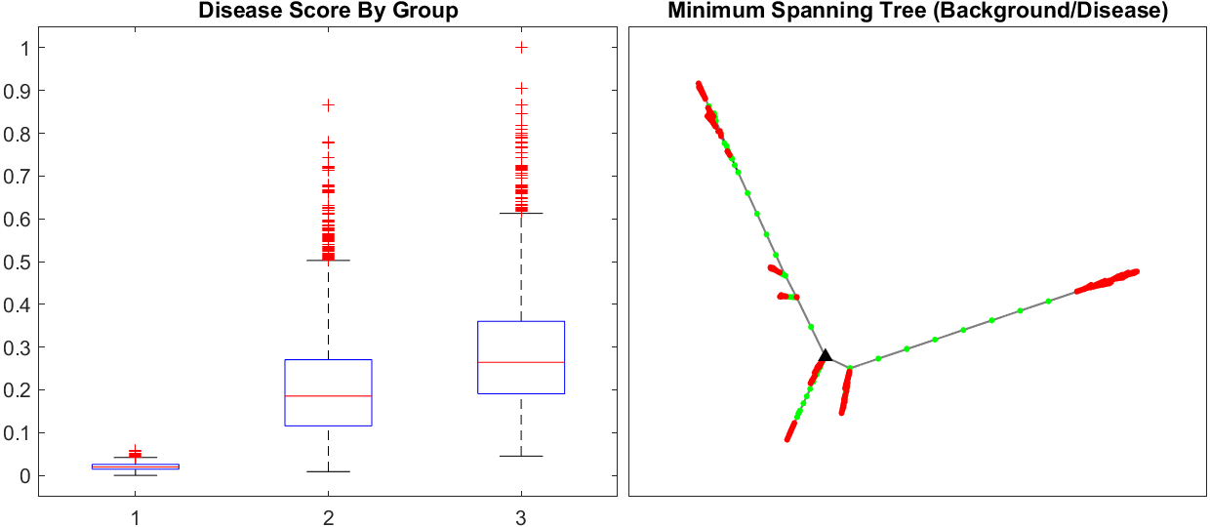
Background (n = 5,858)
Between (n = 20,041)
Disease (n = 2,113)
Use 100% of “Between”/“Disease” and Different Folds of 15% of “Background”
100% of “Between”/“Disease” and 15% of ”Background” (N = ~900) Iteration 5
100% of “Between”/“Disease” and 15% of ”Background” (N = ~900) Iteration 6

Slide 57
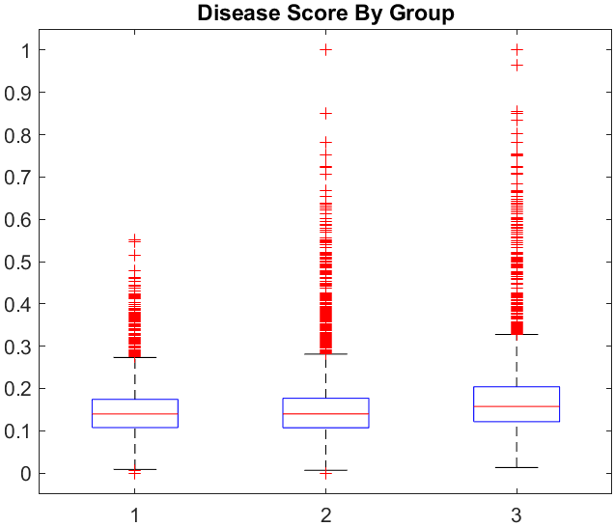
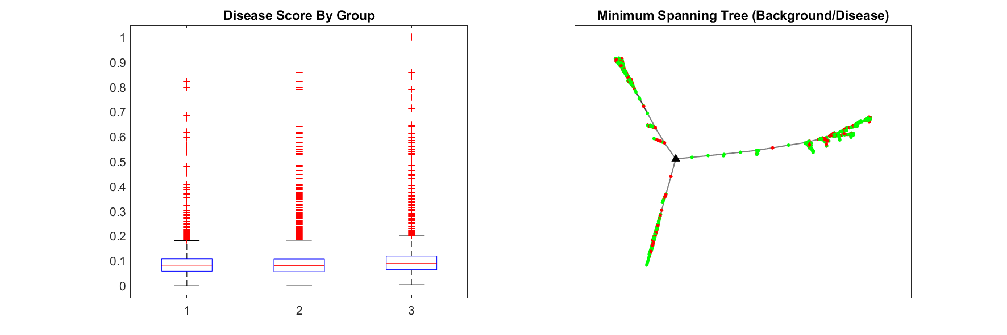
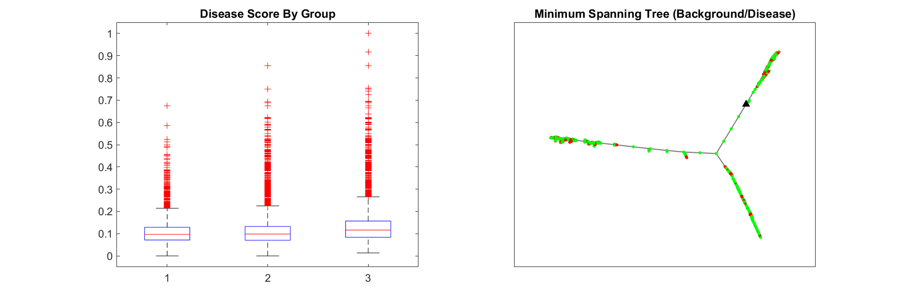
Using Subset of Variables On 100% Data
Use ~415 variables from smaller run as input into 100% data run
Output has ~70 significant variables
(Original 100% run on ~1000 variables also outputted 70 significant variables)
Use ~70 variables from the 100% data run as input into the 100% data run
Output has ~65 significant variables
Use ~390 variables from smaller run as input into 100% data run which did not overlap with the ~70 variables in the 100% data run
Output has ~65 significant variables

Slide 58
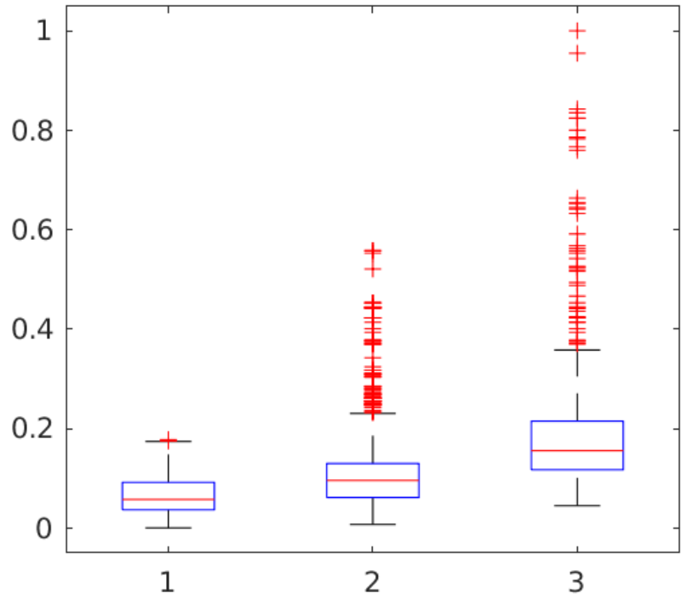
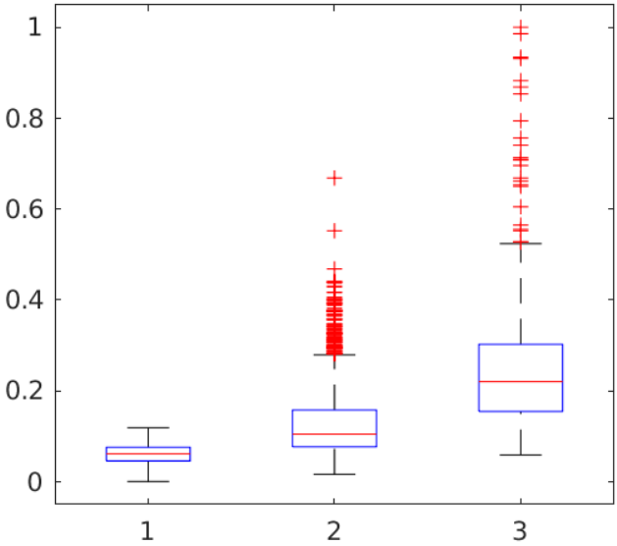
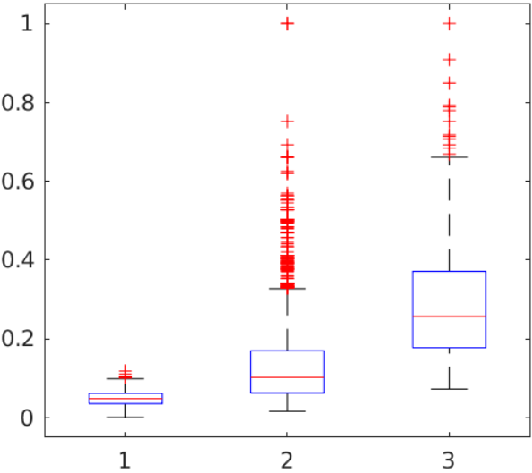
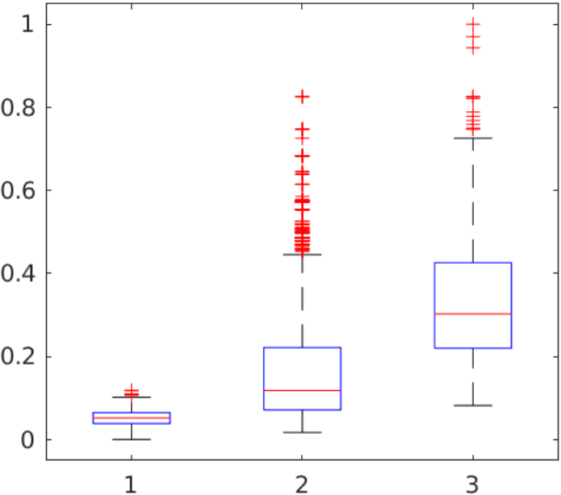
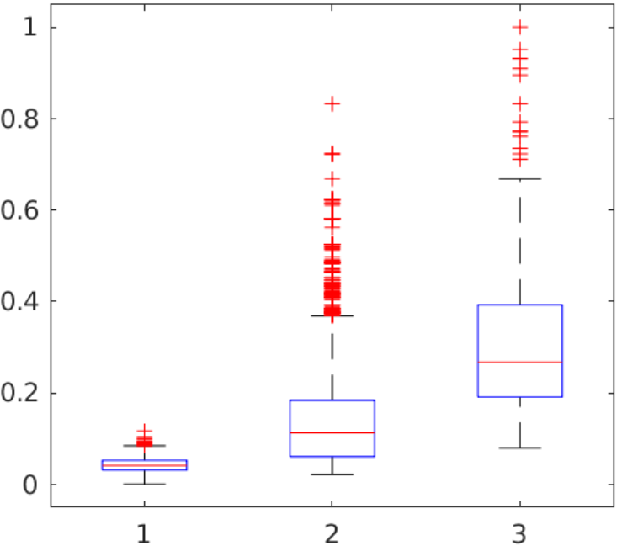
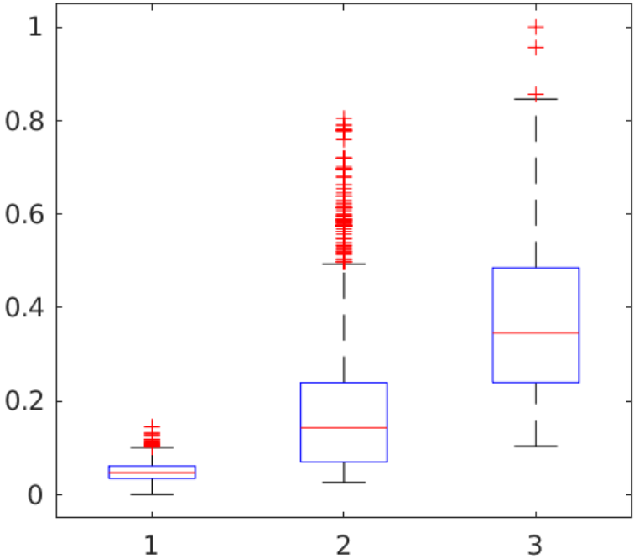
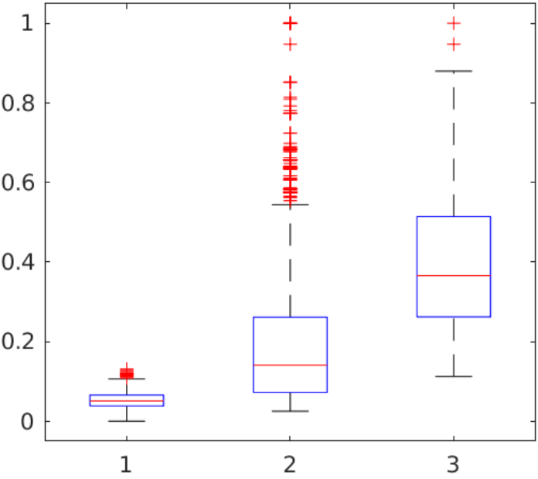
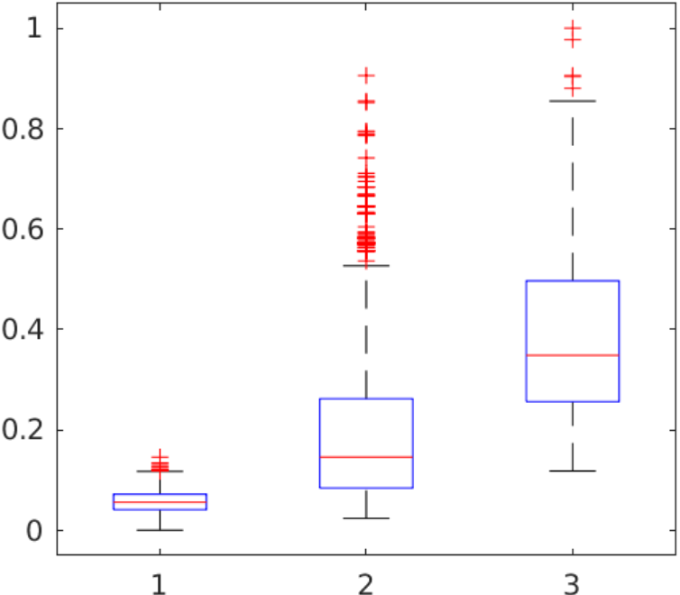
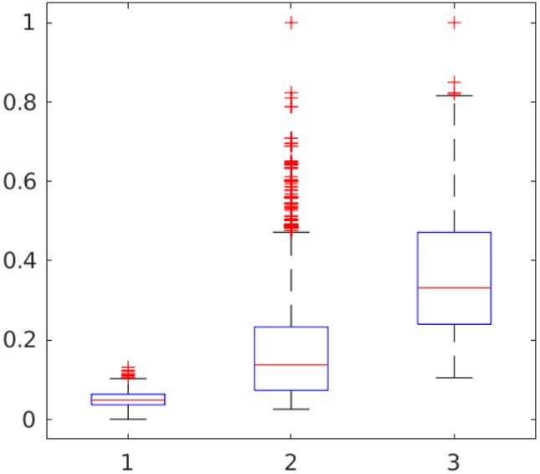

Removing Outliers (20%)
20% of UK Biobank
(N = 6000)
Remove scores > 0.4 from before
(N = 5939, 61 less)
Remove scores > 0.55 from before
(N = 5915, 24 less)
Remove scores > 0.65 from before
(N = 5893, 22 less)
Remove scores > 0.65 from before
(N = 5835, 58 less)
Remove scores > 0.65 from before
(N = 5815, 20 less)
Remove scores > 0.8 from before
(N = 5808, 7 less)
Remove scores > 0.85 from before
(N = 5793, 15 less)
Remove scores > 0.85 from before
(N = 5783, 10 less)
Remove scores > 0.8 from before
(N = 5774, 9 less)

Slide 59
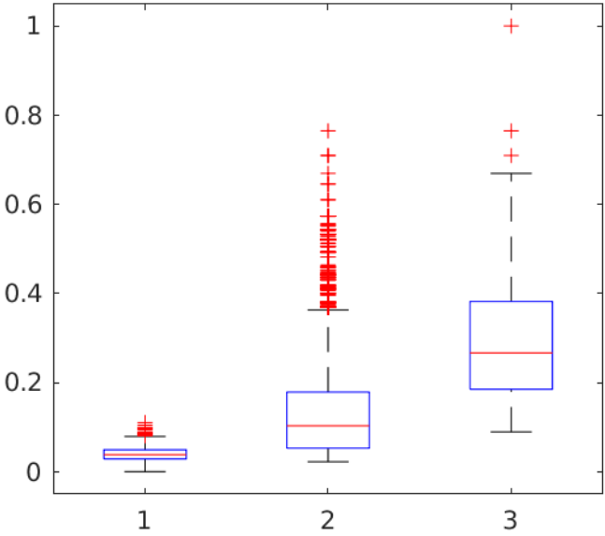
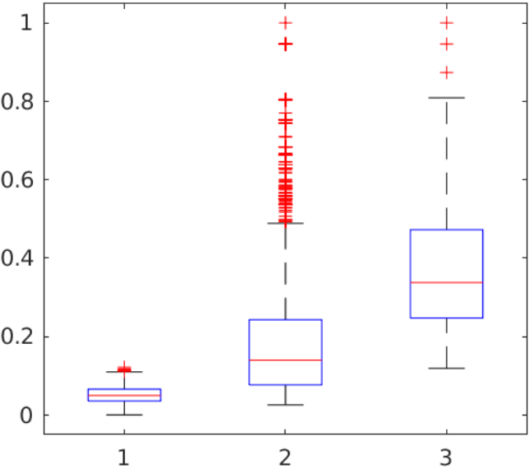
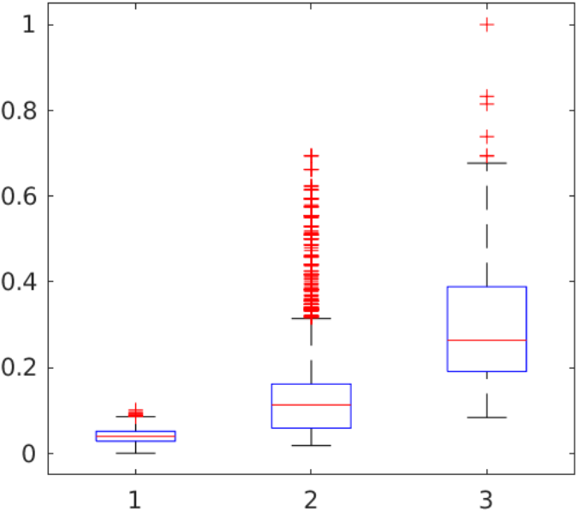


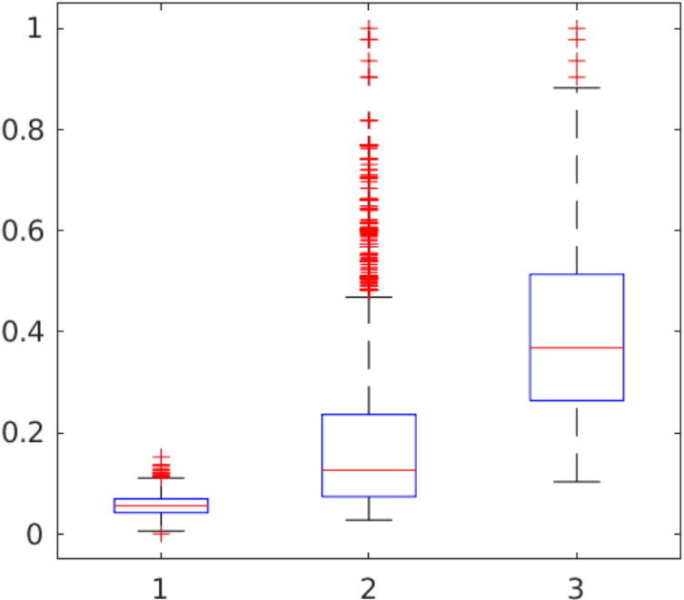
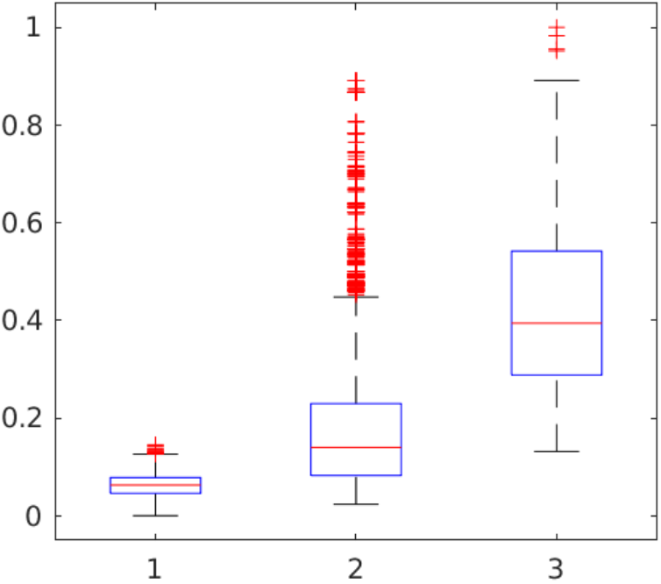



Removing Outliers (20%)
Remove scores > 0.9 from before
(N = 5768, 6 less)
Remove scores > 0.65 from before
(N = 5760, 8 less)
Remove scores > 0.8 from before
(N = 5735, 25 less)
Remove scores > 0.7 from before
(N = 5731, 4 less)
Remove scores > 0.85 from before
(N = 5722, 9 less)
Remove scores > 0.8 from before
(N = 5703, 19 less)
Remove scores > 0.9 from before
(N = 5692, 11 less)
Remove scores > 0.9 from before
(N = 5688, 4 less)
Remove scores > 0.8 from before
(N = 5674, 14 less)
Remove scores > 0.9 from before
(N = 5671, 3 less)

Slide 60





Removing Outliers (50%)

Slide 61










Removing Outliers (50%)

Slide 62










Removing Outliers (50%)

Slide 63










Removing Outliers (100%)

Slide 64










Removing Outliers (100%)

Slide 65





Removing Outliers (100%)

Slide 66
Tightening Background Group Definition

Slide 67



Redefine Background Definition
100% of “Between”/“Disease” and 20% of ”Background”
Background = <120/80 (n = 1200)
100% of “Between”/“Disease” and 20% of ”Background”
Background = <120/70 (n = 1200)
100% of “Between”/“Disease” and 20% of ”Background”
Background = <110/70 (n = 1200)

Slide 68



Filtering Prior Events (Remove Heart Attack/Stroke/Angina/Prefer not to answer)
100% of “Between”/“Disease” and 20% of ”Background” (n = 1200)
Remove prior high blood pressure from background
100% of “Between”/“Disease” and 20% of ”Background” (n = 1200)
Remove prior high blood pressure from background and make sure all these patients are in disease
100% of “Between”/“Disease” and 20% of ”Background” (n = 1200)
Remove prior high blood pressure from all

Slide 69


Filtering Prior Events (Remove Heart Attack/Stroke/Angina/Prefer not to answer)
100% of “Between”/“Disease” and 20% of ”Background” (n = 1200)
100% of “Between”/“Disease” and 20% of ”Background” (n = 1200)
Remove prior high blood pressure from background
100% of “Between”/“Disease” and 100% of ”Background” (n = 5500)
Remove prior high blood pressure from background

Slide 70


More Strict Blood Pressure Filtering & Remove Blood Pressure Medication From Background
Filter blood pressure medication from background
Filter high blood pressure recorded at any time/visit from background (1200 Background patients)
Filter blood pressure medication from background
Filter high blood pressure recorded at any time/visit from background (2000 Background patients)

Slide 71



Stricter Event Filtering & Remove BP Medication & Stricter BP Filter From Background
Original
(5800 Background, 2100 Disease)
More Stricter Prior Events Filter: Use All Prior Instances/Remove High BP from Background
(5550 Background, 2100 Disease)
More Stricter Prior Events Filter + Remove BP Medication from Background
(5550 Background, 2100 Disease)
Remove Events + BP Medication + More Strict BP Filter (93/94)
(5200 Background, 2100 Disease)
Remove Events + BP Medication + More Strict BP Filter (PWA)
(2100 Background, 2100 Disease)
Remove Events + BP Medication + More Strict BP Filter (PWA + 12697/12698)
(2000 Background, 2100 Disease)
Remove Events + BP Medication + More Strict BP Filter (4079/4080)
(1500 Background, 2100 Disease)
Remove Events + BP Medication + More Strict BP Filter (All)
(800 Background, 2100 Disease)

Slide 72
Fixed BP Bug (Was Using Automatic BP Reading Instance 0 Before, Now Using Instance 2)

Slide 73



Stricter Event Filtering & Remove BP Medication & Stricter BP Filter From Background
and Remove Instance >= 3
Use both Automatic Blood Pressure Readings Instance 2 During Initial Filter
Remove Events + BP Medication (Remove Instance 3+)
(3250 Background, 3894 Disease, 18177 Between)
Remove Events + BP Medication + More Strict BP Filter (4079/4080 instance 0/1/2) (1269 Background, 3894 Disease)
Remove Events + BP Medication + More Strict BP Filter (93/94 instance 0/1/2) + Remove Instance 3+
(1269 Background, 3894 Disease)
This was same as to the right as the initial filtering criteria did no include manual readings
Remove Events + BP Medication + More Strict BP Filter (auto+manual) + Remove Instance 3+
(1269 Background, 3894 Disease)

Slide 74

Stricter Event Filtering & Remove BP Medication & Stricter BP Filter From Background
and Remove Instance >= 3
Use both Automatic Blood Pressure Readings Instance 0 + 2 During Initial Filter
Did not do these two runs as increases data (less data filtering) and would definitely be worse than the one of the left
Remove Events + BP Medication + More Strict BP Filter (4079/4080 Instance 0+1+2)
(1797 Background, 4423 Disease, Total = 30029)
This performed worse than the last slide as there were probably many patients who had a instance 0 but did not participate in follow up
Remove Events + BP Medication + More Strict BP Filter (4079/4080 Instance 1+2)
(XXX Background, XXX Disease)
Remove Events + BP Medication + More Strict BP Filter (4079/4080 Instance 2)
(XXX Background, XXX Disease)
Remove Events + BP Medication + More Strict BP Filter (4079/4080 Instance 0+1+2) + (93/94 Instance 0+1+2)
(1797 Background, 4423 Disease)
This was same as to the left as the initial filtering criteria did no include manual readings

Slide 75









Stricter Event Filtering & Remove BP Medication & Stricter BP Filter From Background
and Remove Instance >= 3
Use both Automatic/Manual Blood Pressure Readings Instance 2 During Initial Filter
Remove Events + BP Medication + More Strict BP Filter (All 4079/4080)
(1380 Background, 4199 Disease, Total = 27338)

Slide 76






Is the Scaling Issue a Numerical Issue?
650 Background
800 Background
850 Background
900 Background
1000 Background
1100 Background
1200 Background
1380 Background

Slide 77





Is the Scaling Issue a Numerical Issue? Test Using Un-Filtered UKB Dataset (Keep # Disease Same)
1500 Background
1300 Background
1100 Background
900 Background
700 Background
500 Background

Slide 78



Filtering cPCs to Improve Score Distribution
These methods are flawed as the cTI is done before filtering, need a method to do filtering directly on the patient data before cTI but then eigen matrix containers larger outliers the more data we use
Filter cPCs > 3sd
Filter cPCs > 2.5sd
Filter cPCs > 2sd

Slide 79



Removing Patients with Large cPCs
These methods are flawed as the cTI is done before filtering, need a method to do filtering directly on the patient data before cTI but then eigen matrix containers larger outliers the more data we use
Remove Samples with cPC >3sd before Score Calculation
Remove Samples with cPC >2sd before Score Calculation
Remove Samples with cPC >2sd and Re-Running cTI
(remove 550 diseased samples)

Slide 80


Filtering Eigen Matrix to Improve Score Distribution
Filter Eigen Matrix (Vsort) > 3sd
Filter out eigen vectors in cPCA with large values (slight improvement)
Eigen Value Threshold >0.01
Filter Overall Eigen Matrix (V) > 3sd (slight improvement)
Filter Overall Eigen Matrix (Vmedoid) > 3sd
Limit Alpha to Small Values

Slide 81




Filtering Eigen Vectors Containing Large Values
Filter Out Any Eigen Vector with Value Above 0.3
Filter Out Any Eigen Vector with Value Above 0.25
Filter Out Any Eigen Vector with Value Above 0.2
Filter Out Any Eigen Vector with Value Above 0.15
Is there a certain threshold for each dataset we can use to filter out eigen vectors with large outliers?
Filter Out Any Eigen Vector with Value Above 0.125
Filter Out Any Eigen Vector with Value Above 0.1

Slide 82

Blood Pressure vs Disease Score

Slide 83

Variable Contribution from cTI Model Output

Slide 84
Is Size the Main Issue?

Slide 85




Sampling Patients in Individual Groups
Randomly sampling the number of patients in background group
Gradually reducing the number of patients in the background group
Original Model
N = 1400 (Background)
Sample 80% of Background Group, Keep Rest the Same
N = 1100 (Background)
Sample 66% of Background Group, Keep Rest the Same
N = 950 (Background)
Sample 50% of Background Group, Keep Rest the Same
N = 700 (Background)

Slide 86




Sampling Patients in Individual Groups – Unfiltered Data
Randomly sampling the background population with a less strict background definition (high BP diagnosis, medication, only imaging BP readings)
Gradually reducing the number of patients in the background group
Full Model
N = 3000 (Background)
Sample Background to be the Same as Last Slide
N = 1400 (Background)
Sample Background to be the Same as Last Slide
N = 1100 (Background)
Sample Background to be the Same as Last Slide
N = 700 (Background)

Slide 87




Sampling Patients in Individual Groups – Unfiltered Data
Random sampling patients outside of the initial “strict background definition” (patients who have prior high BP diagnosis, are on BP medication, have had 1 or more high blood pressure reading)
Gradually reducing the number of patients in the background group
Full Model
N = 1600 (Background)
Sample Background to be the Same as Last Slide
N = 1400 (Background)
Sample Background to be the Same as Last Slide
N = 1100 (Background)
Sample Background to be the Same as Last Slide
N = 700 (Background)

Slide 88



Sampling Patients in Individual Groups
Randomly sampling the number of patients in disease group
Original Model
N = 4200 (Diseased)
Sample 50% of Disease Group, Keep Rest the Same
N = 2100 (Diseased)
Sample 33% of Disease Group, Keep Rest the Same
N = 1400 (Diseased)
Sample 25% of Disease Group, Keep Rest the Same
N = 1050 (Diseased)

Slide 89




Sampling Patients in Individual Groups – Randomize Groups
Completely shuffle the blood pressure group labels
Maintain the distribution of number of patients in each group (background = 1400, disease = 4200)
Sample Background to be the Same as Last Slide
N = 1400 (Background)
Sample Background to be the Same as Last Slide
N = 1100 (Background)
Sample Background to be the Same as Last Slide
N = 950 (Background)
Sample Background to be the Same as Last Slide
N = 700 (Background)

Slide 90
Recap of Contrastive Trajectory Inference Method
cPCA:
cPCA is performed by computing a weighted sum between the covariance of the background (cov_{b}) and diseased (cov_{d}) group over a range of α’s (~100 values from 10⁻² to 10²): $cov = cov_{d} – α× cov_{b}$
Perform eigen decomposition of the resulting covariance matrix

Slide 91

Runs on subsets of dataset (rows) when only using blood pressure (dia & sys) as inputs into the model

Slide 92
Current Theory/Speculation
cPCA method forces the background to be “small” in comparison to the disease
When we reach a certain number of columns, the model struggles to discriminate useful features since we have so many rows (previously untested)
Using subset of features will improve feature identification when using cPCA

Slide 93
More Feature Selection

Slide 94


Blood Pressure at Different Study Centres
Visit 0
Visit 2

Slide 95
Data Harmonization
Didn’t make any difference

Slide 96
Kernel Smoothing cPCA
Didn’t make any difference

Slide 97



Subsets of Features
All Variables (M = 1086)
Cardiac + Brain + Carotid + Abdominal + Body Composition + Arterial Stiffness + Blood + Spirometry + ECG + Baseline
Cardiac Variables (M = 36)
Cardiac + Carotid + Arterial Stiffness + Baseline
Brain + Baseline (M = 866)
Cardiac + Brain + Carotid + Arterial Stiffness + Baseline (M = 914)

Slide 98




Subsets of Features
All Variables Except Brain
(M = 222)
Cardiac + Carotid + Abdominal + Body Composition + Arterial Stiffness + Blood + Spirometry + ECG + Baseline
Brain + Body Comp + Baseline Variables
(M = 978)
Cardiac + Body Comp + Baseline Variables
(M = 157)
Non-Imaging Variables
(M = 191)
Body Composition + Blood + Spirometry + ECG + Baseline

Slide 99



Subsets of Features
Body Comp + Baseline Variables
(M = 122)
Brain + Baseline Variables (Co-Cor)
(M = 738)
Cardiac MR + Baseline Variables
(M = 22)
Abdominal MR + Baseline Variables
(M =)

Slide 100








Subsets of Features – Individual Feature Sets (Updated)
Cardiac MR + Baseline Variables
(M = 22)
Brain MR + Baseline (M = 858)
Carotid + Baseline Variables
(M = 14)
ECG + Baseline Variables
(M = 9)
Body Comp + Baseline Variables
(M = 126)
Spirometry + Baseline Variables
(M = 6)
Blood + Baseline Variables
(M = 64)
Baseline Variables Only (Age + Sex)
(M = 2)

Slide 101







Subsets of Features - Brain
Category = 110
(M = 19)
Category = 112
(M = 4)
Category = 1102
(M = 16)
Category = 109
(M = 17)
Category = 134
(M = 430)
Category = 135
(M = 243)
Category = 1101
(M = 140)

Slide 102



Subsets of Features – Body Composition
Category = 124
(M = 14)
Category = 125
(M = 50)
Category = 100009
(M = 65)

Slide 103



Subsets of Features – Blood
Category = 100081
(M = 32)
Category = 17518
(M = 30)
Category = 100083
(M = 9)

Slide 104


Subsets of Features – Choosing the Features Which Looked Best
Cardiac MR (all) + Brain MR (112/1102/109) + Body Composition (124)
(M = 64)
Cardiac MR (all) + Brain MR (112/1102/109/135) + Body Composition (124)
(M = 305)

Slide 105
Subsets of Features – Removing Feature Subsets Until Results Become Worse
Remove subsets with a large number of variables first
Current best is cardiac MR, brain MR, body composition, blood

Slide 106
Refinement

Slide 107

Covariance of all background (1400)

Slide 108

Covariance of subset background (500)
Covariance of subset background (500)

Slide 109


Covariance of subset background (500)
Covariance of subset background (500)

Slide 110


Covariance of subset background (500)
Covariance of subset background (500)

Slide 111

Covariance of all background (1400)
Cov_background(1400) – Cov_background(500)

Slide 112

Covariance of all background (1400)
Cov_background(1400) – Cov_background(500)

Slide 113





Cov_d – 10*cov_b (1400)
Cov_d – 10*cov_b (500)

Slide 114


Best Model So Far
[1] "Optimal Threshold at 0.128 (Sensitivity = 87.6%, Specificity = 87.8%)"
[1] "Confusion Matrix:"
[1] "(Pred/GT) True False"
[1] "True 87.6% 12.2%"
[1] "False 12.4% 87.8%"

Slide 115


Remove Bodycomp (123)
[1] "Optimal Threshold at 0.130 (Sensitivity = 84.8%, Specificity = 84.7%)"
[1] "Confusion Matrix:"
[1] "(Pred/GT) True False"
[1] "True 84.8% 15.3%"
[1] "False 15.2% 84.7%"

Slide 116


Remove Cardiac MR (19)
[1] "Optimal Threshold at 0.152 (Sensitivity = 87.6%, Specificity = 87.7%)"
[1] "Confusion Matrix:"
[1] "(Pred/GT) True False"
[1] "True 87.6% 12.3%"
[1] "False 12.4% 87.7%"

Slide 117


Remove Blood (61)
[1] "Optimal Threshold at 0.113 (Sensitivity = 87.5%, Specificity = 87.9%)"
[1] "Confusion Matrix:"
[1] "(Pred/GT) True False"
[1] "True 87.5% 12.1%"
[1] "False 12.5% 87.9%"

Slide 118


Remove Brain MR (862)
[1] "Optimal Threshold at 0.035 (Sensitivity = 70.8%, Specificity = 71.5%)"
[1] "Confusion Matrix:"
[1] "(Pred/GT) True False"
[1] "True 70.8% 28.5%"
[1] "False 29.2% 71.5%"

Slide 119


Remove High Co-Correlation in Bodycomp (124 -> 36)
[1] "Optimal Threshold at 0.110 (Sensitivity = 91.1%, Specificity = 91.0%)"
[1] "Confusion Matrix:"
[1] "(Pred/GT) True False"
[1] "True 91.1% 9.0%"
[1] "False 8.9% 91.0%"

Slide 120


Remove High Co-Correlation in Bodycomp (124 -> 36)
Remove Brain MR (862)
[1] "Optimal Threshold at 0.152 (Sensitivity = 59.7%, Specificity = 59.2%)"
[1] "Confusion Matrix:"
[1] "(Pred/GT) True False"
[1] "True 59.7% 40.8%"
[1] "False 40.3% 59.2%"

Slide 121


Remove High Co-Correlation in Bodycomp (124 -> 36)
Remove Cardiac MR (19)
[1] "Optimal Threshold at 0.117 (Sensitivity = 84.0%, Specificity = 83.8%)"
[1] "Confusion Matrix:"
[1] "(Pred/GT) True False"
[1] "True 84.0% 16.2%"
[1] "False 16.0% 83.8%"

Slide 122


Remove High Co-Correlation in Bodycomp (124 -> 27)
Remove High Co-Correlation Brain MR (860 -> 501)
[1] "Optimal Threshold at 0.188 (Sensitivity = 84.1%, Specificity = 84.2%)"
[1] "Confusion Matrix:"
[1] "(Pred/GT) True False"
[1] "True 84.1% 15.8%"
[1] "False 15.9% 84.2%"

Slide 123



Remove High Co-Correlation in Bodycomp (124 -> 27)
Remove High Co-Correlation Brain MR (860 -> 501)
Both Using Same Contrast Covariance Matrix Filtering (1080 -> 630 total variables left)
[1] "AUC is 0.94559 when using 1001 Logarithmic Intervals"
[1] "Optimal Threshold at 0.188 (Sensitivity = 87.0%, Specificity = 86.9%)"
[1] "Confusion Matrix:"
[1] "(Pred/GT) True False"
[1] "True 87.0% 13.1%"
[1] "False 13.0% 86.9%"

Slide 124
Variable Understanding

Slide 125




----- Number of cPCs: 17
----- Alpha Selected: 8.6851
[1] "112 Significant Columns (cTI Selected) Contributed to 73.2% of the Total Weighting"
[1] "AUC is 0.92297"
[1] "Optimal Threshold at 0.177 (Sensitivity = 84.6%, Specificity = 84.5%)"
[1] "Confusion Matrix:"
[1] "(Pred/GT) True False"
[1] "True 84.6% 15.5%"
[1] "False 15.4% 84.5%

Slide 126


Slide 127


Slide 128


Slide 129


Slide 130


Slide 131


Slide 132


Slide 133


Slide 134


Slide 135


Slide 136


Slide 137


Slide 138



Slide 139



Slide 140



Slide 141



Slide 142



Slide 143



Slide 144


Slide 145


Slide 146


Slide 147


Slide 148


Slide 149


Slide 150


Slide 151


Slide 152


Slide 153


Slide 154


Slide 155



Slide 156



Slide 157



Slide 158




Slide 159


Slide 160


Slide 161


Slide 162


Slide 163


Slide 164


Slide 165


Slide 166


Slide 168

613 measurements

Slide 169


Limit Hyper Score range to 0-0.6
Limit Hyper Score range to 0-0.5

Slide 170

610 measurements

Slide 171


Limit Hyper Score range to 0-0.6
Limit Hyper Score range to 0-0.5

Slide 172

2447 measurements

Slide 173

2669 measurements

Slide 175


All Variables (No Ft Selection)
Co-Cor Ft Selection Only
(Imbalanced Brain/Body Comp Variables)

Slide 176


Co-Cor Ft Selection + Brain
Co-Cor Ft Selection + Body Comp

Slide 177


Mean per (10) intervals
Median per (10) intervals

Slide 178


Mean per (20) intervals
Median per (20) intervals

